Slide 1



Erasmus+ Project: We Are the Same Despite Our Differences
SP 19 Gdańsk 2025/26 - Integration for Erasmus Youth
Integration – What It Is and Why It Matters

Slide 2
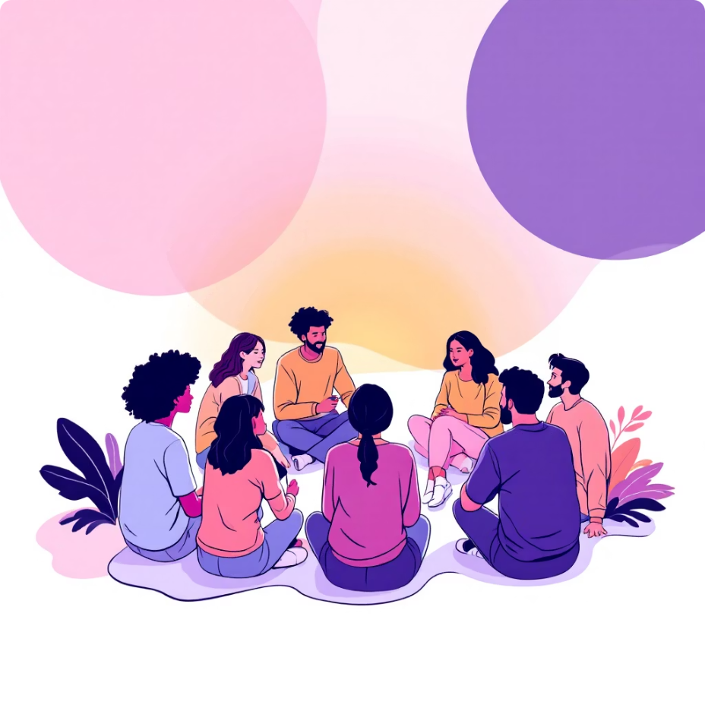
Understanding Integration
What is Integration?
Integration means working and living together in a group, sharing ideas, and respecting each other. We are all different. This is natural and important. But we can learn acceptance and respect, and turn our differences into a strength.
Integration is important in Erasmus groups, school classes, and all kinds of groups.
Understanding Others
Working Together
Integration helps us see the world through different perspectives and learn from diverse experiences.
When we integrate well, we collaborate more effectively and achieve better results as a team.
Feeling Included
Integration is very important for children's learning because children do not learn well in places where they feel bad or uncomfortable. Feeling accepted and happy helps them focus and enjoy learning.
Integration ensures everyone feels valued and part of the group, creating a positive environment.

Slide 3
The Impact of Poor Integration
Isolation and Loneliness
Misunderstandings
Group Problems
People feel alone and disconnected from the group, leading to emotional distress and reduced participation.
Without proper integration, cultural differences and communication barriers create confusion and conflict.
The entire group suffers when members don't integrate well, affecting productivity and morale.
Why Groups Need Integration
In Erasmus groups, school classes, and other groups, integration helps to make friends and learn from each other. When integration is successful, it creates an environment where:
Everyone feels welcome and valued
Cultural exchange happens naturally
Learning becomes more enjoyable and effective
Lasting friendships are formed

Slide 4



How Integration Happens
The Foundation of Integration
Integration happens when people talk, share, and work on activities together. It's not a one-time event but an ongoing process that requires effort from everyone involved.
01
Communication
Open dialogue and active listening
02
Sharing
Exchanging experiences and perspectives
03
Collaboration
Working together on common goals
The Role of a Leader
Facilitating Participation
Conflict Resolution
Encouraging Participation
A leader helps people join in and ensures everyone has a voice in group activities.
Leaders address problems quickly and fairly, maintaining group harmony.
They motivate everyone to contribute and participate actively in group dynamics.
Integration happens step by step, not all at once. It's a natural process that requires patience and understanding from all group members.

Slide 5

The Five Stages of Integration
Forming
Meeting and learning about each other - the initial stage where group members get acquainted and begin to understand different backgrounds and personalities.
Storming
Some conflicts may appear - a natural phase where differences in opinions, working styles, and cultural approaches may create tension within the group.
Norming
The group agrees on rules - members establish common ground, set expectations, and develop shared ways of working together effectively.

Slide 6









Completing the Integration Journey
Performing
The group works well together - members collaborate efficiently, support each other, and achieve their goals as a unified team.
Adjourning
The group finishes the project - members celebrate achievements, reflect on their journey, and maintain the connections they've built.
Practical Ways to Integrate Groups
Group Games
Interactive activities that break down barriers and encourage natural interaction between participants.
Teamwork Tasks
Collaborative projects that require different skills and perspectives to succeed.
Sharing Personal Stories
Creating opportunities for members to share their backgrounds and experiences.
Learning About Cultures
Exploring and celebrating the diverse cultural backgrounds within the group.

Slide 7




Essential Skills for Successful Integration
Active Listening
Respecting Others
Paying full attention to others, understanding their perspectives, and responding thoughtfully to what they share.
Valuing different opinions, backgrounds, and approaches whilst treating everyone with dignity and consideration.
Communicating Clearly
Helping Each Other
Expressing ideas effectively, asking questions when unsure, and ensuring messages are understood by all.
Offering support, sharing knowledge, and being willing to assist group members when they need help.

Slide 8

The Rewards of Good Integration
100%
2x
95%
∞
More Friends
Better Teamwork
Enhanced Learning
Fun and Support
Integration creates lasting friendships that extend beyond the programme duration.
Well-integrated groups achieve twice as much through effective collaboration.
Students report significantly better learning experiences in integrated environments.
The joy and mutual support in integrated groups creates unlimited positive experiences.
Long-term Benefits
Good integration doesn't just improve the immediate experience - it creates lasting benefits that extend far beyond the programme:
Improved intercultural competence
Enhanced language skills
Greater confidence in diverse settings
Valuable international network
Personal growth and self-awareness

Slide 9
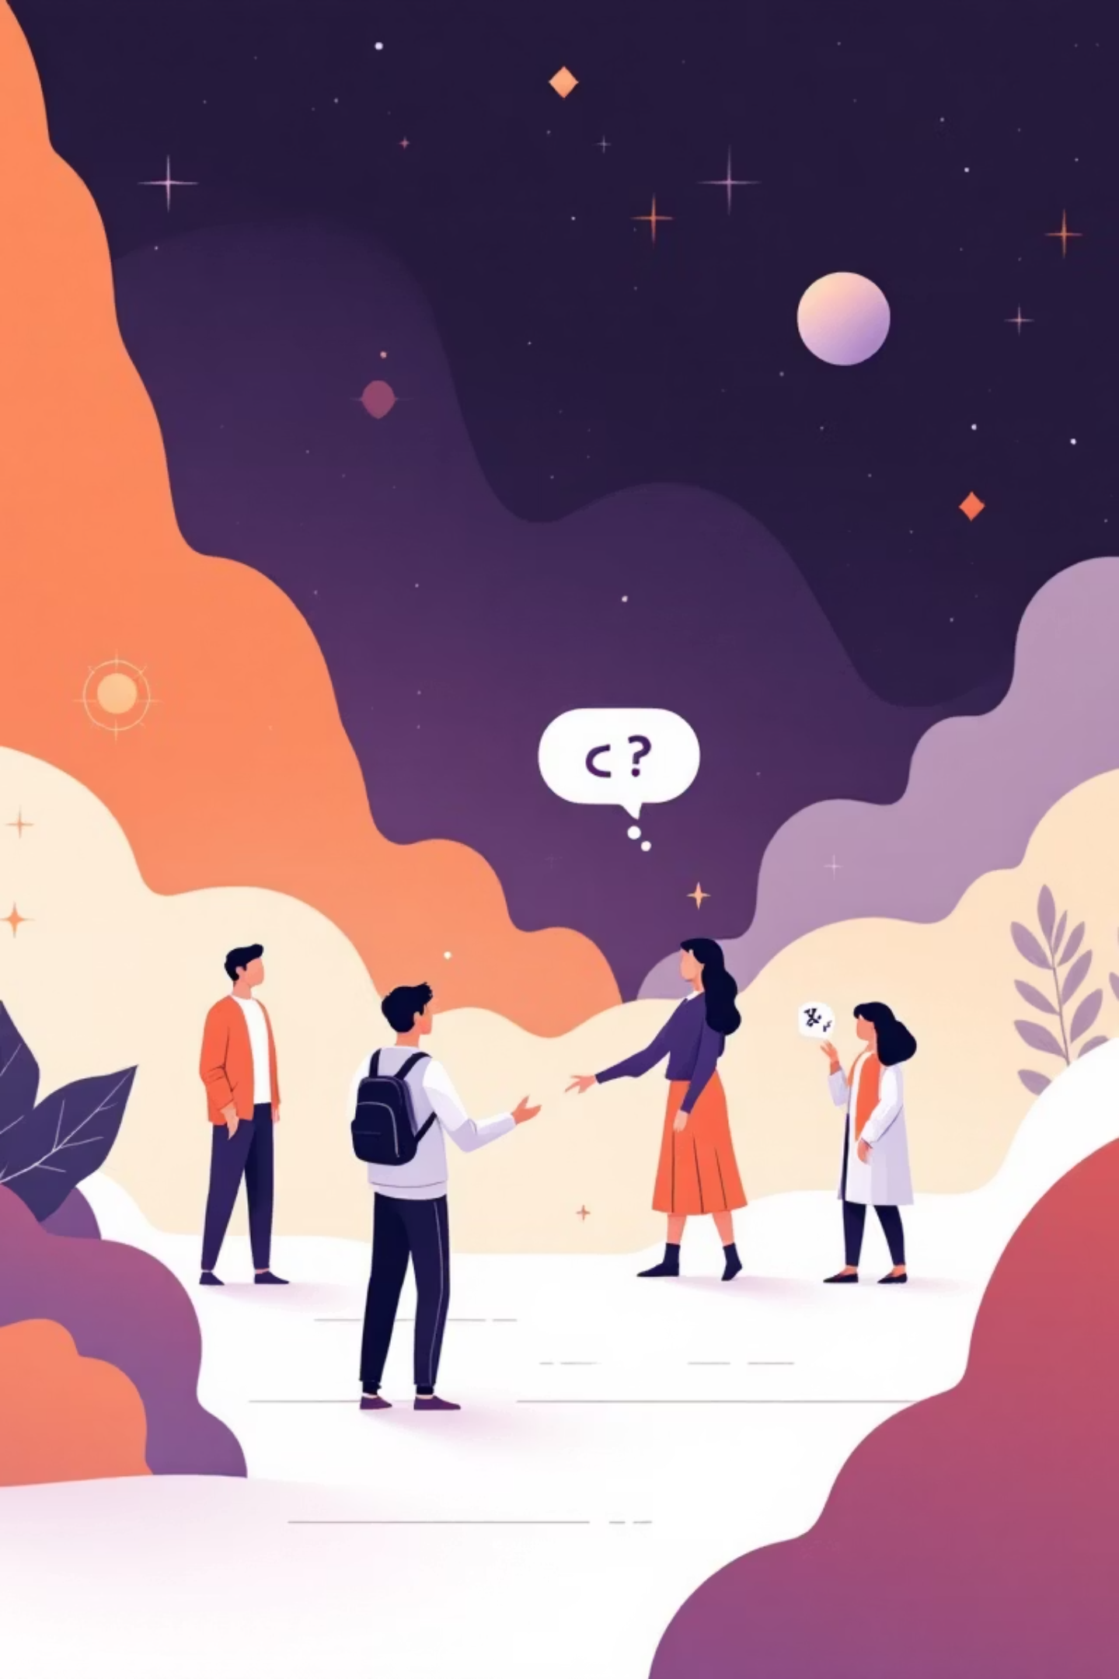

Common Integration Challenges
1
Language Barriers
Different levels of English proficiency can create communication difficulties and misunderstandings between group members.
2
Cultural Differences
Varying cultural norms, values, and social expectations can lead to confusion and unintentional conflicts.
3
Shyness and Introversion
Some participants may struggle to open up and participate actively due to personality traits or cultural backgrounds.
4
Interpersonal Conflicts
Disagreements and personality clashes can arise when people with different backgrounds work closely together.
Remember: These challenges are normal and expected. They're not failures - they're opportunities for growth and learning.

Slide 10





Overcoming Integration Challenges
Be Patient
Integration takes time. Allow relationships to develop naturally and don't rush the process.
Ask Questions
When you don't understand something, ask for clarification. Curiosity builds bridges between cultures.
Include Shy People
Actively encourage quieter members to participate and create safe spaces for them to contribute.
Solve Problems Calmly
Address conflicts with empathy and understanding, focusing on solutions rather than blame.
Integration is for Everyone
It makes our Erasmus experience, school life, and all group work better and more fun! When we embrace integration, we don't just improve our immediate experience - we develop skills and relationships that will benefit us throughout our lives.
Your journey of integration starts now. Every conversation, every shared moment, and every act of kindness contributes to building a stronger, more connected community.

