Slide 1
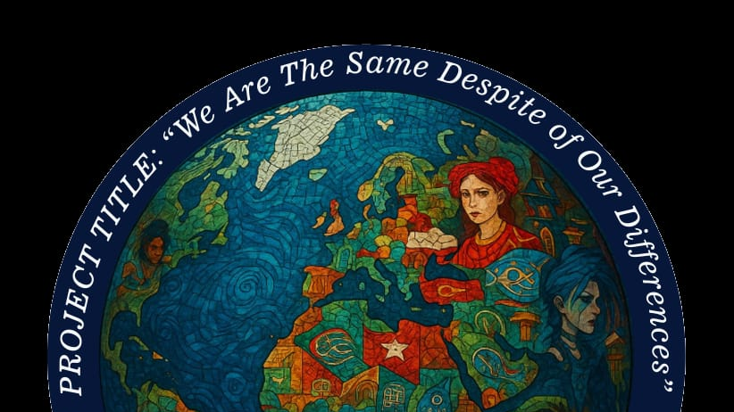
„We are the same despite our differences”
2025-2026

Slide 2
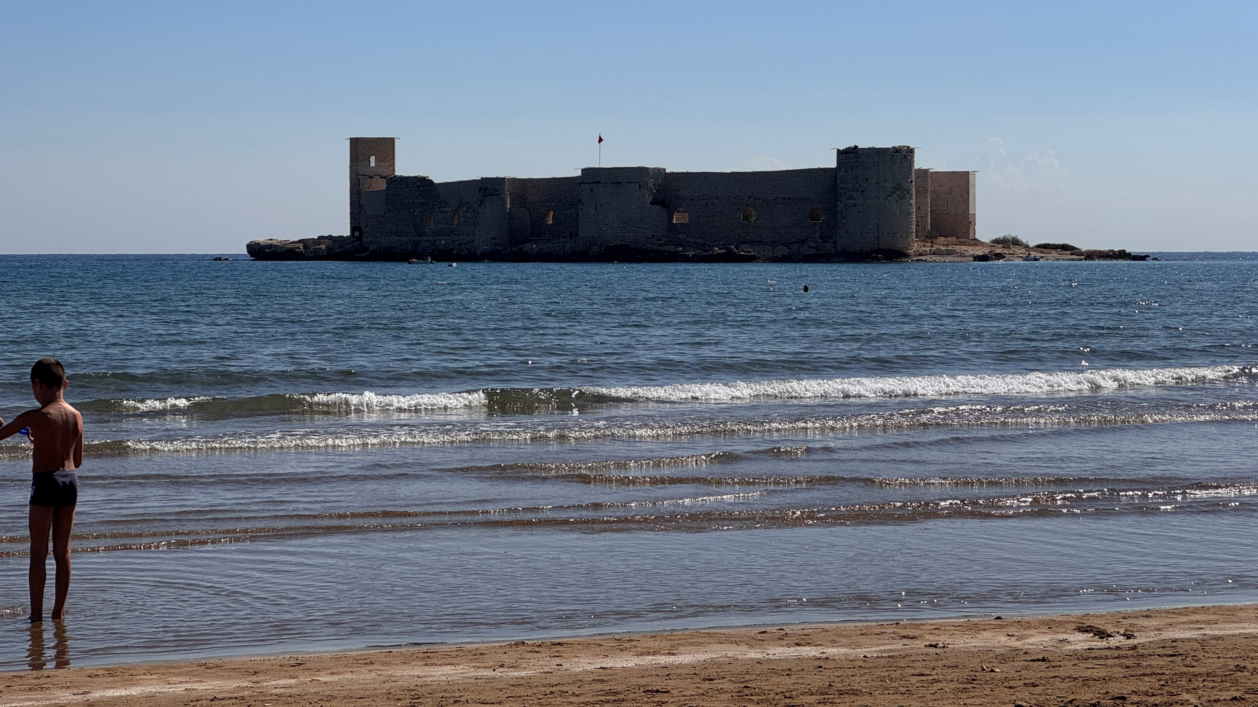
13-18.10.2025
Turkey trip

Slide 3
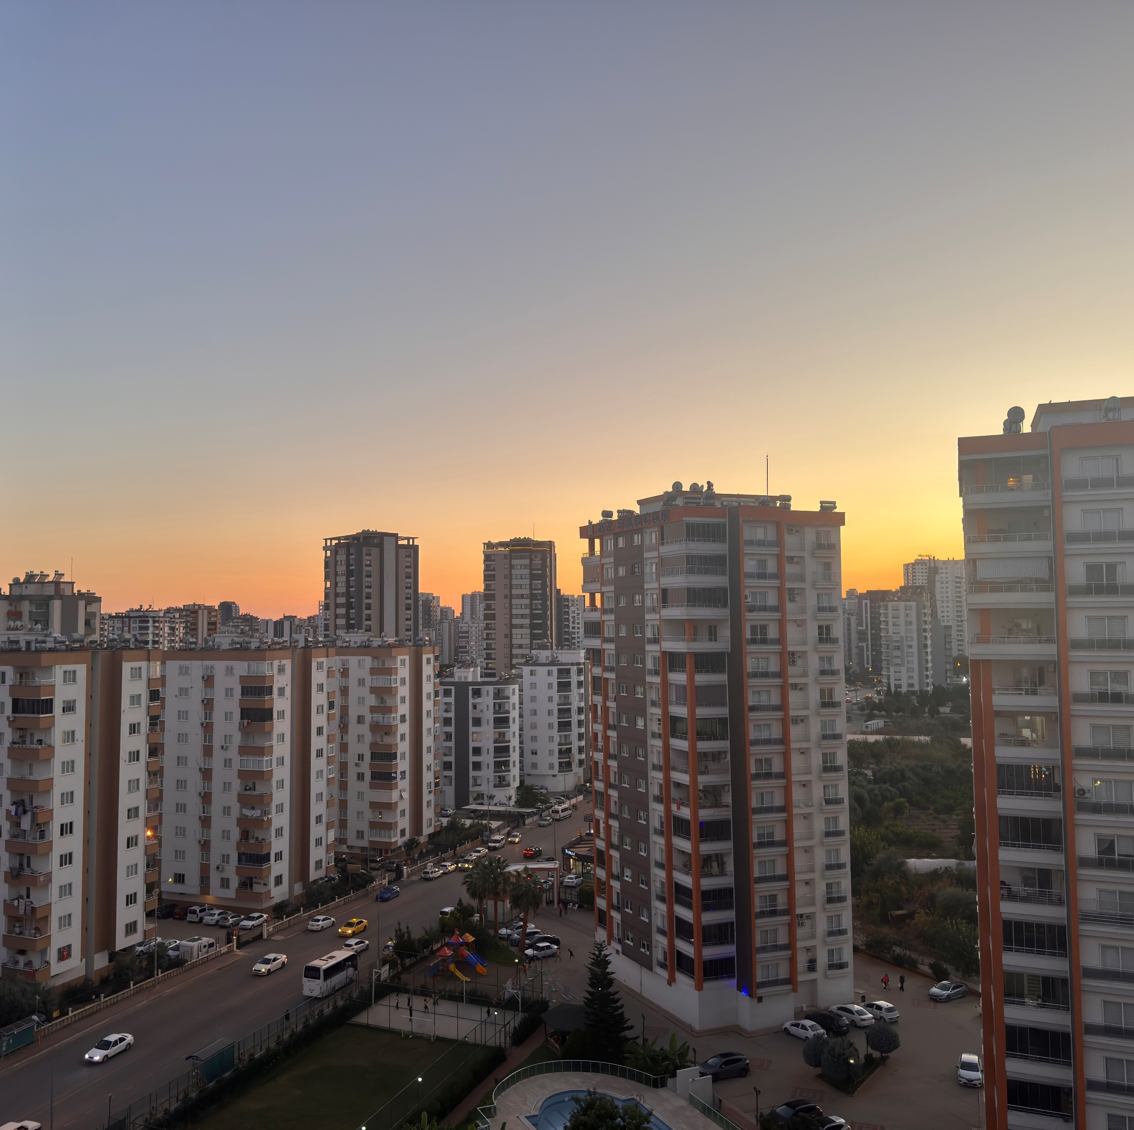
Sunday
On Sunday evening we arrived in Mersin and met with people we were staying with

Slide 4
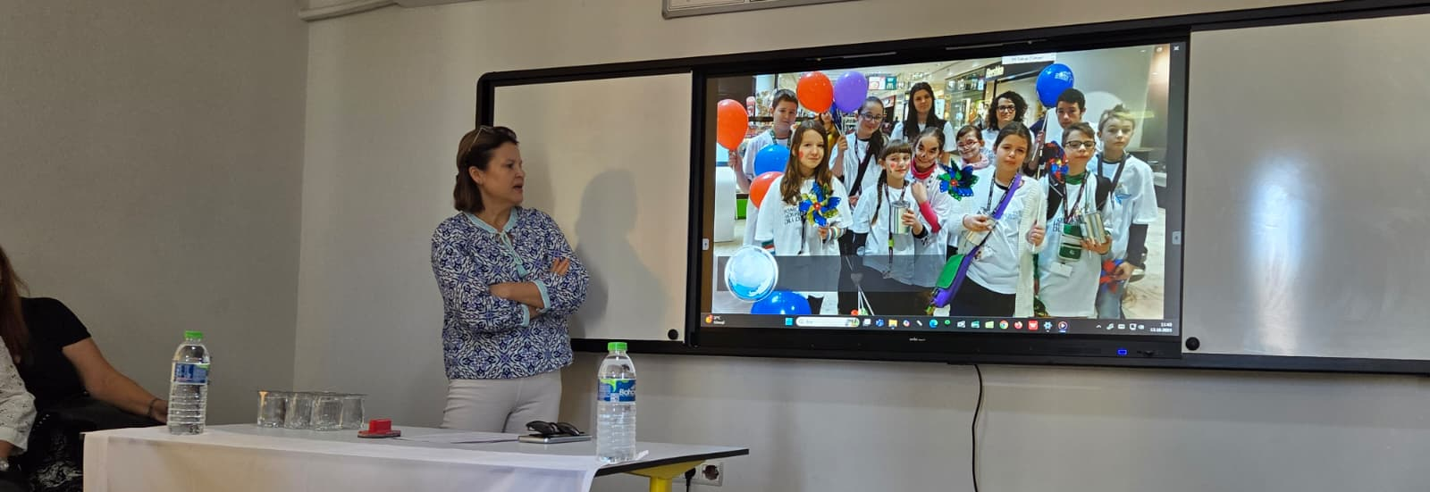
Monday
We went to the school to talk about integration, school and education system in our countries.

Slide 5
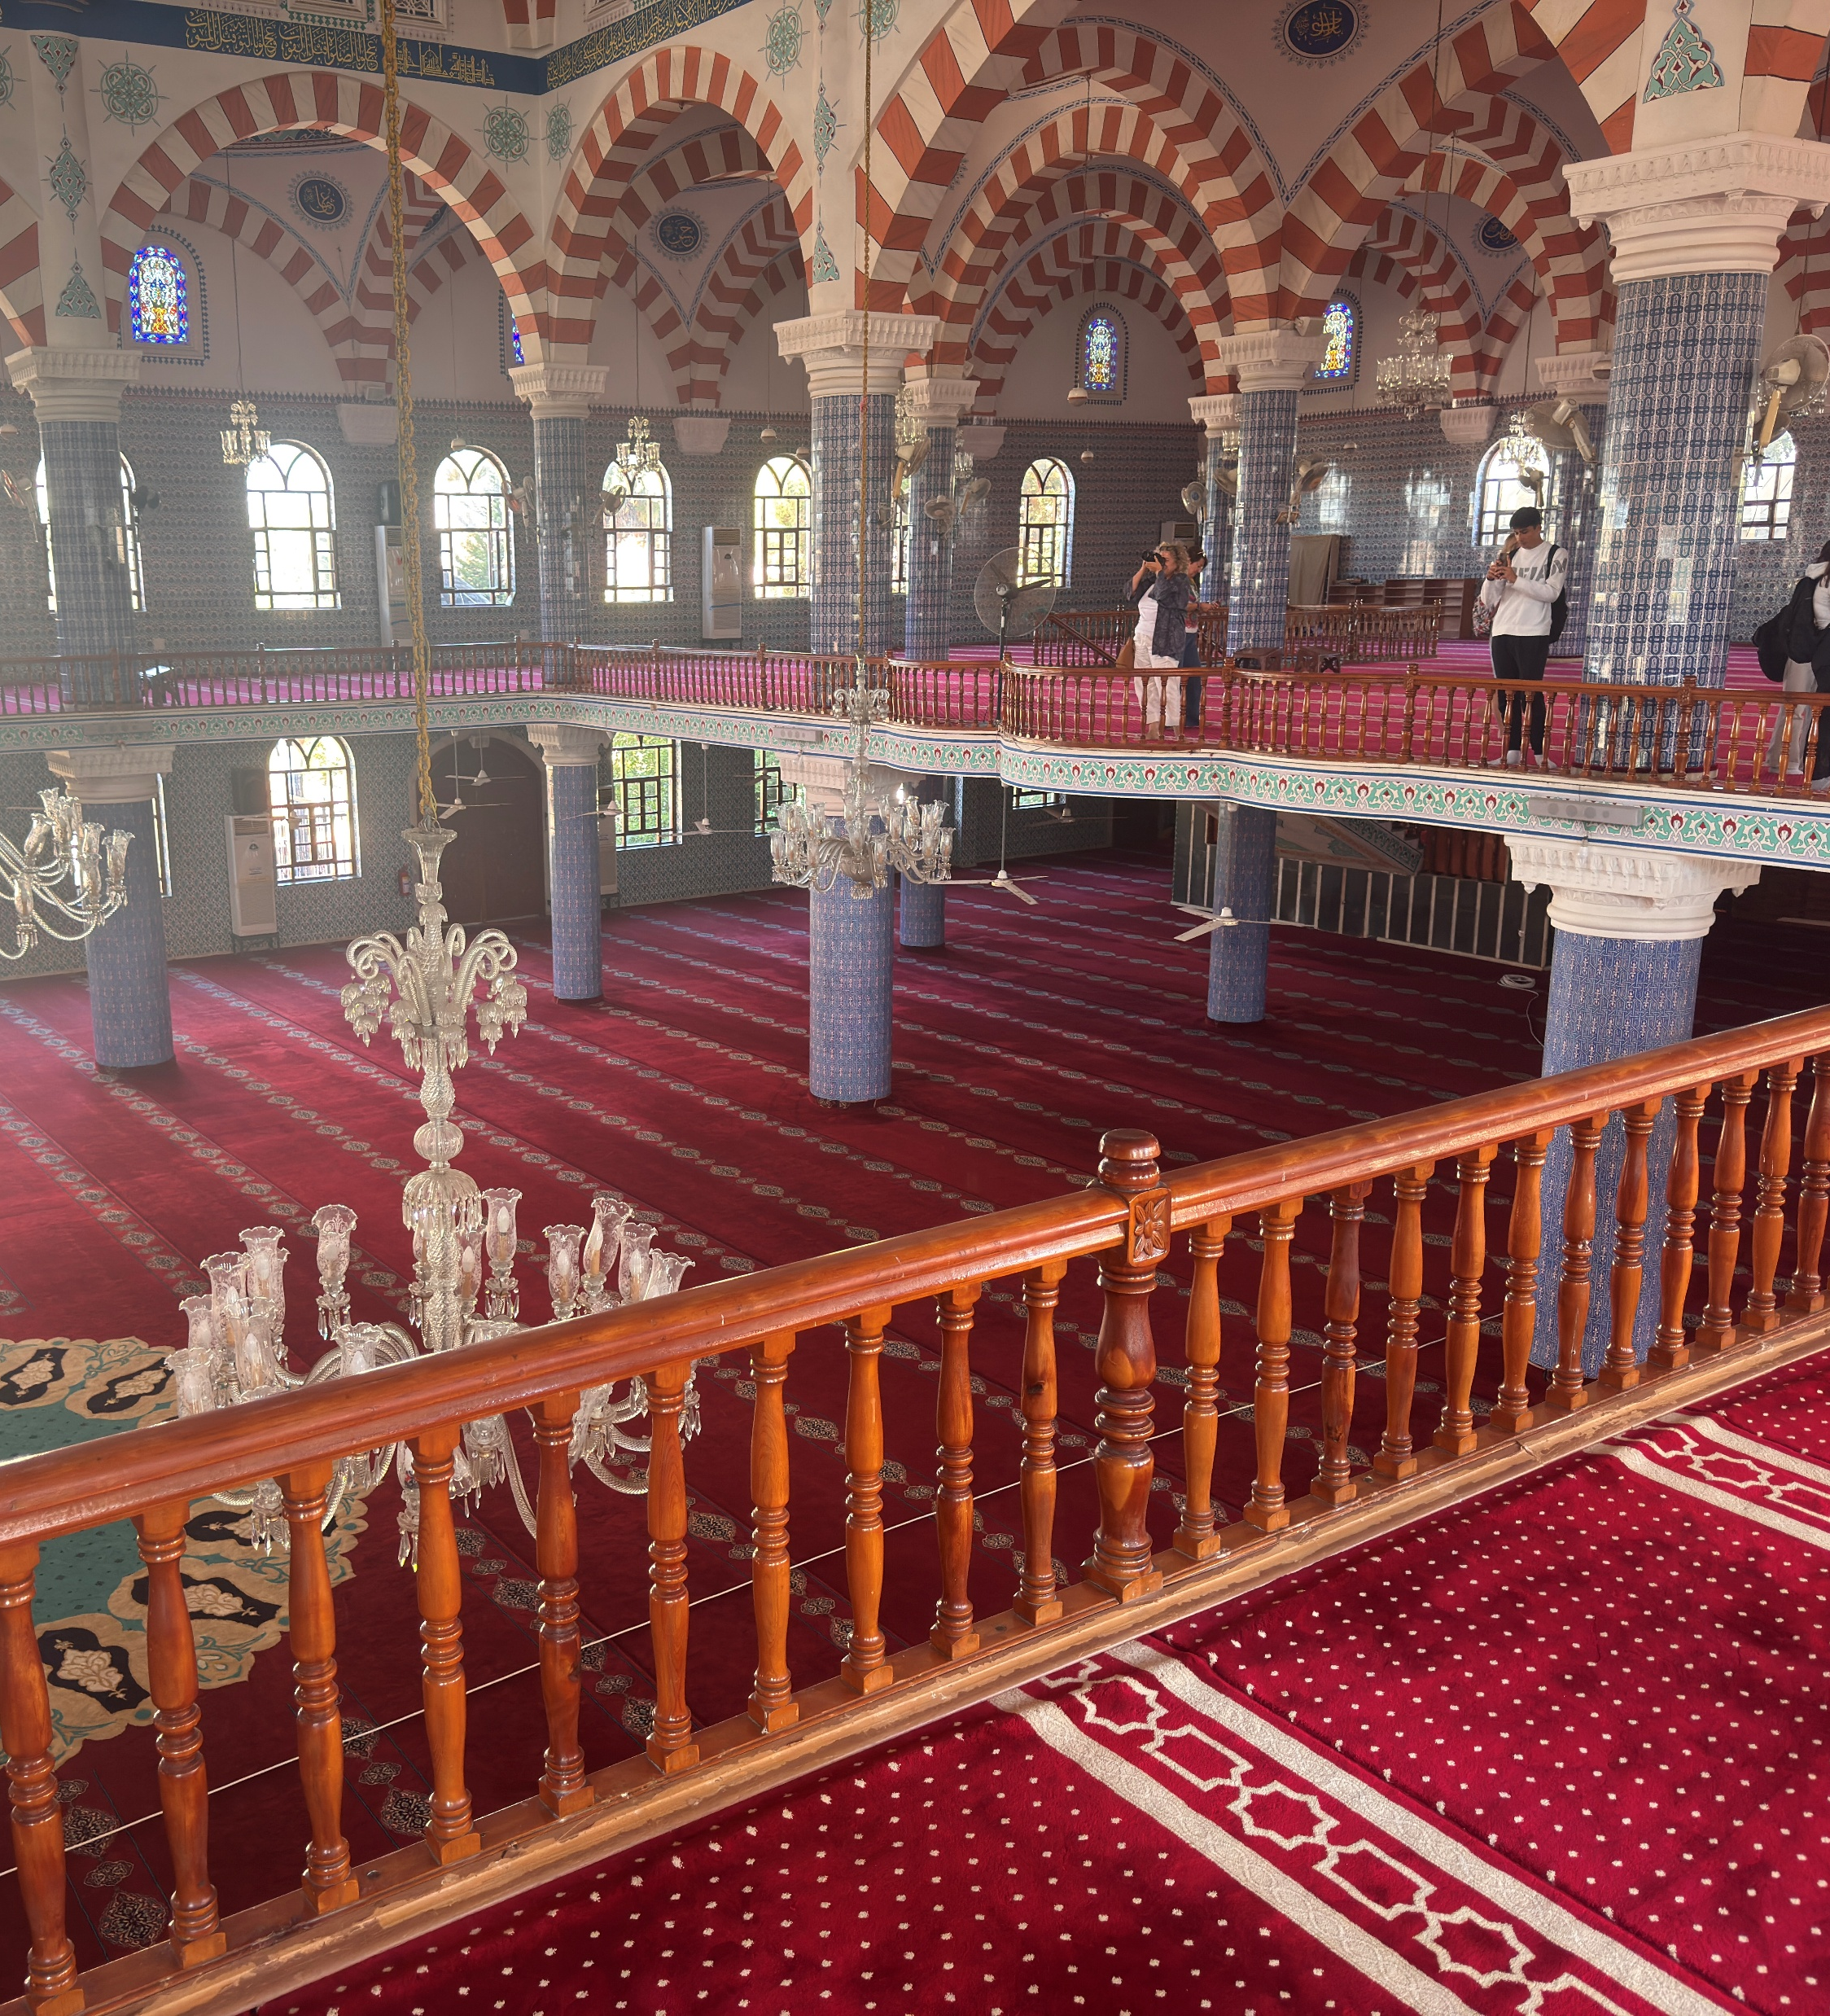
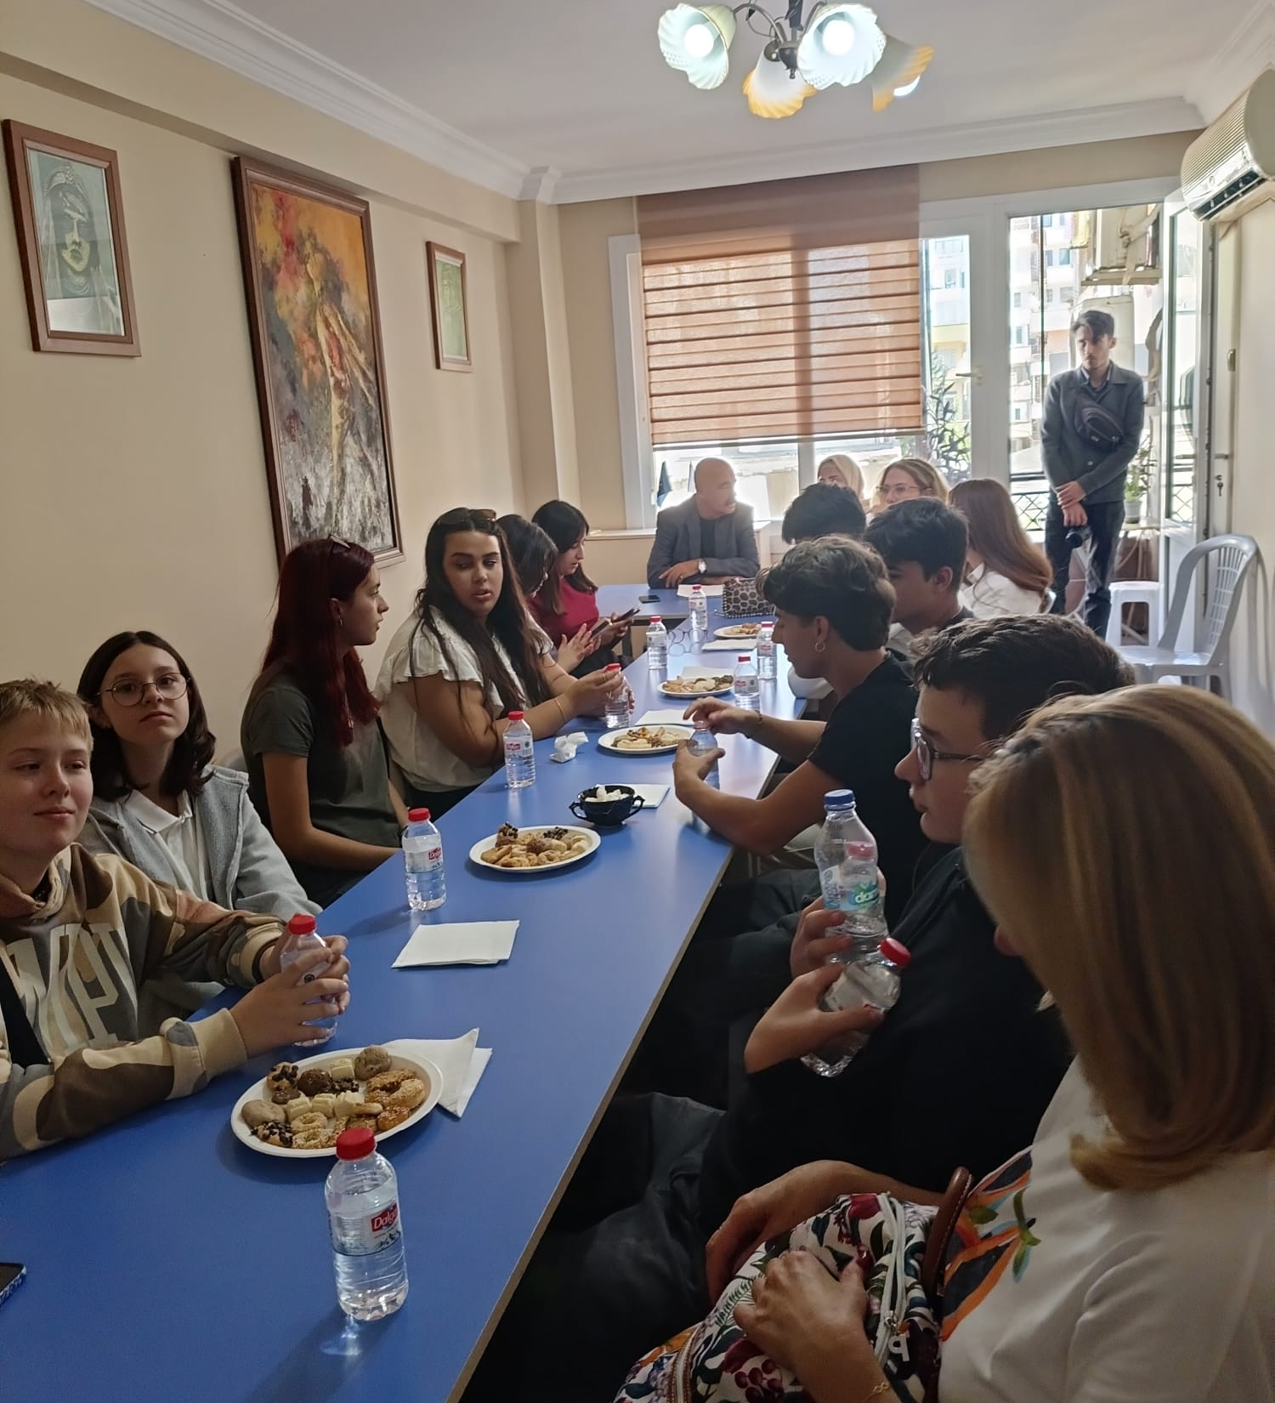
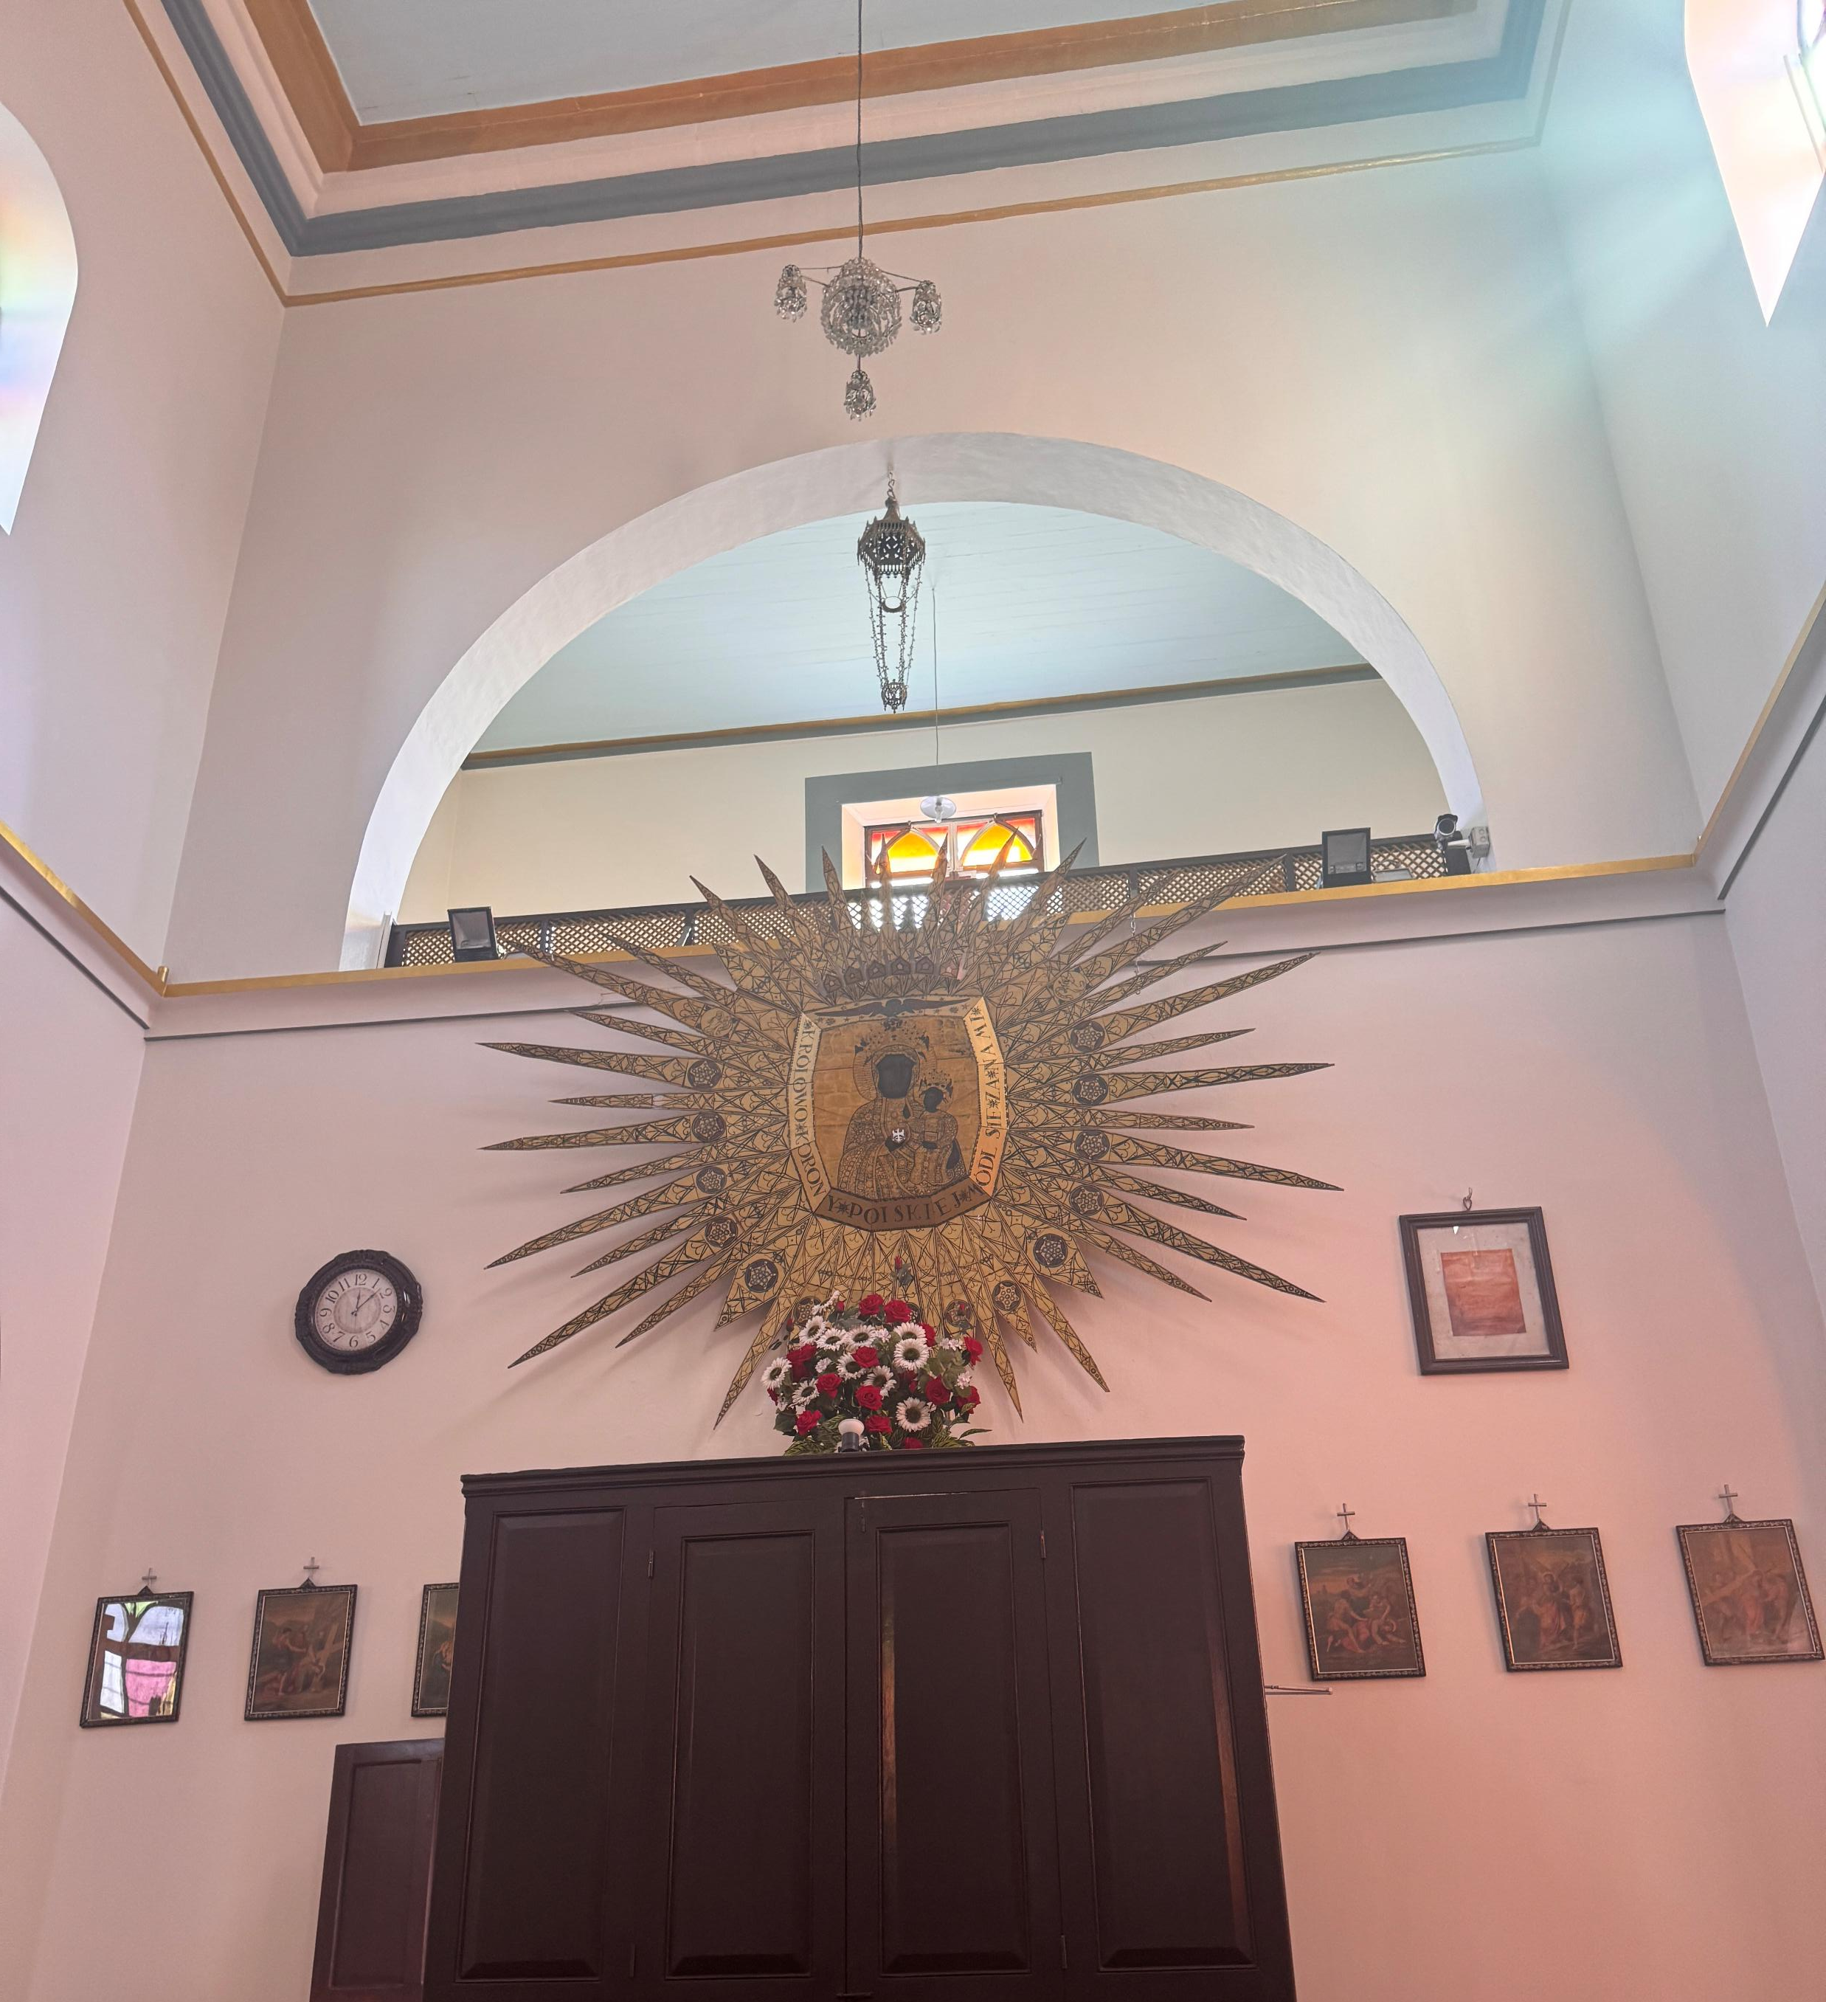
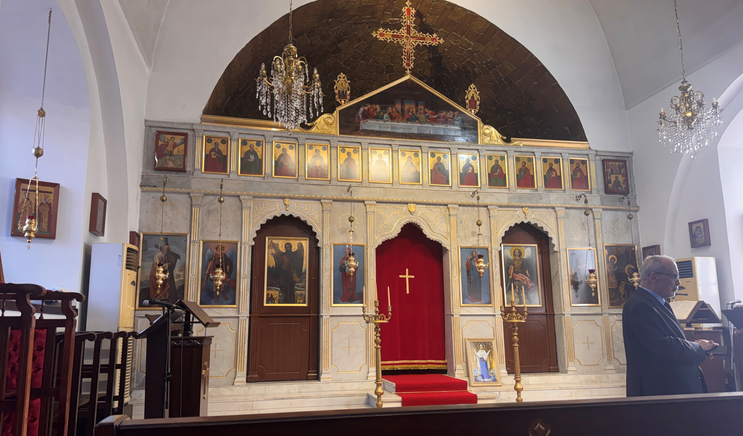
Tuesday
We had a trip to a mosque and two catholic churches and visited immigration centre

Slide 6

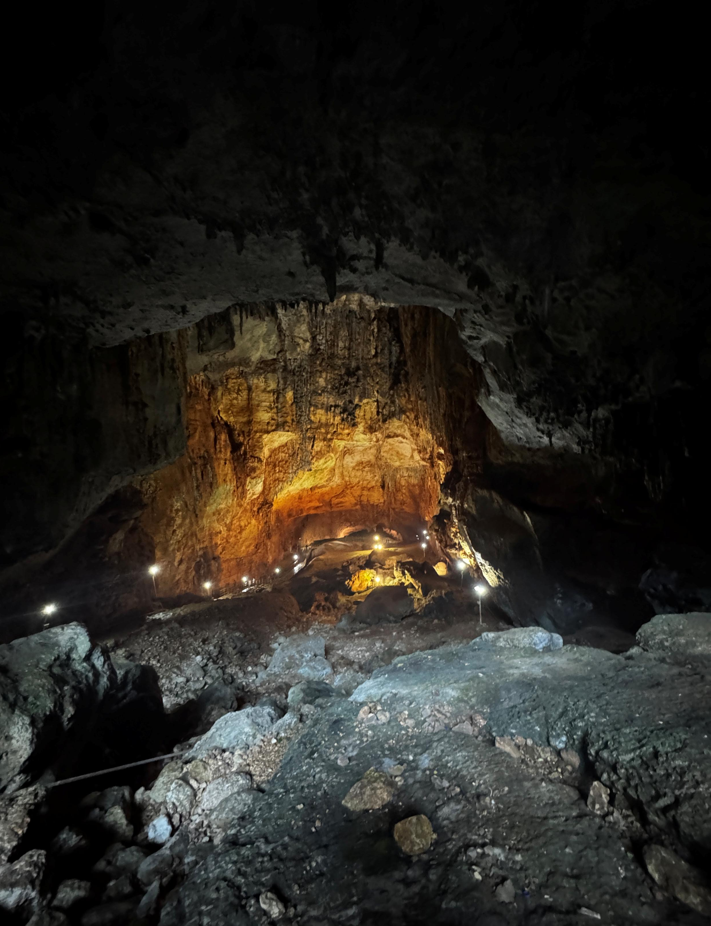
Wednesday
We went to the beach then two sinkholes ,,Hell’’ and ,,Heaven’’ wich we could enter

Slide 7
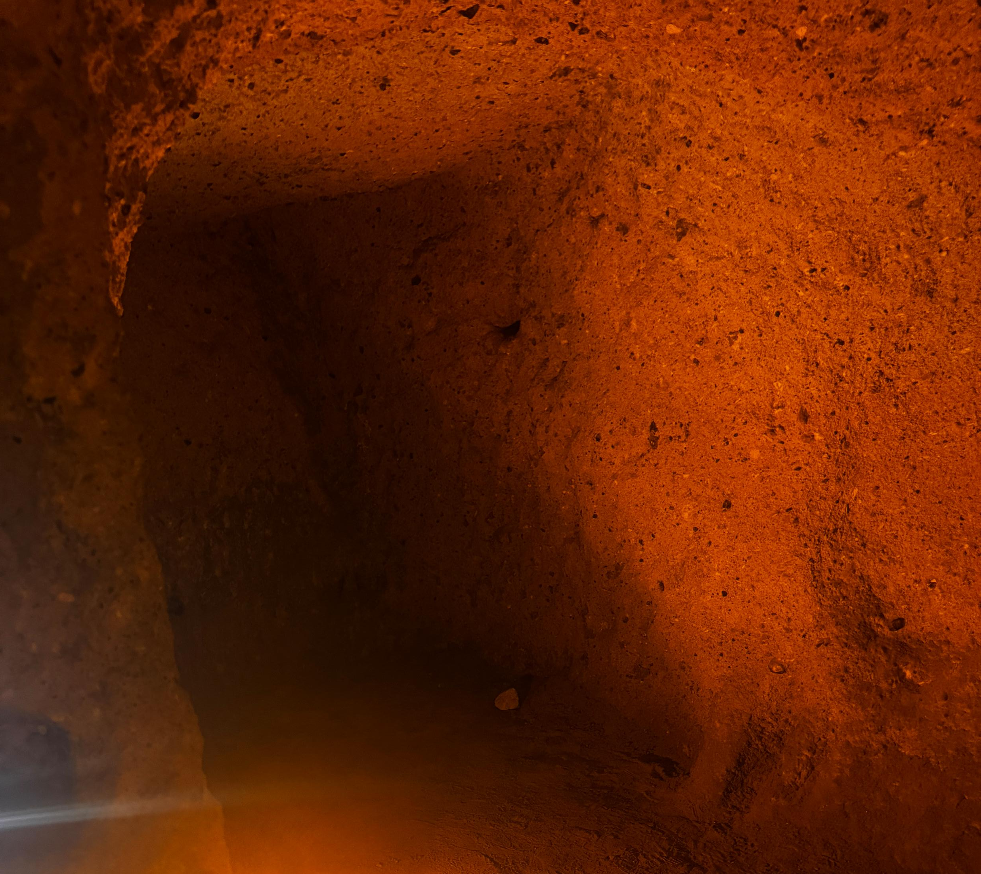
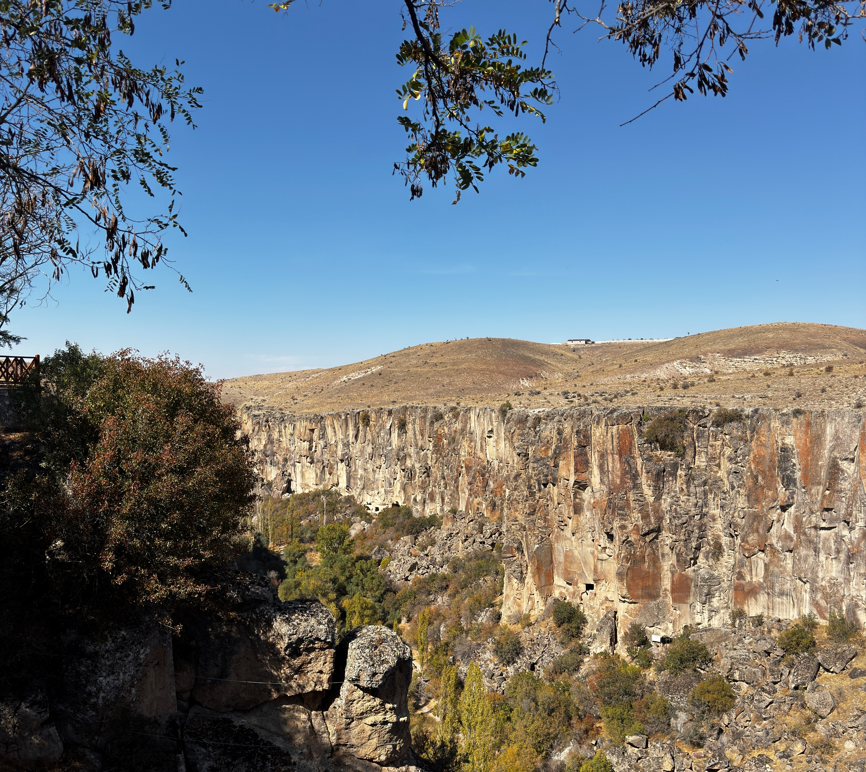
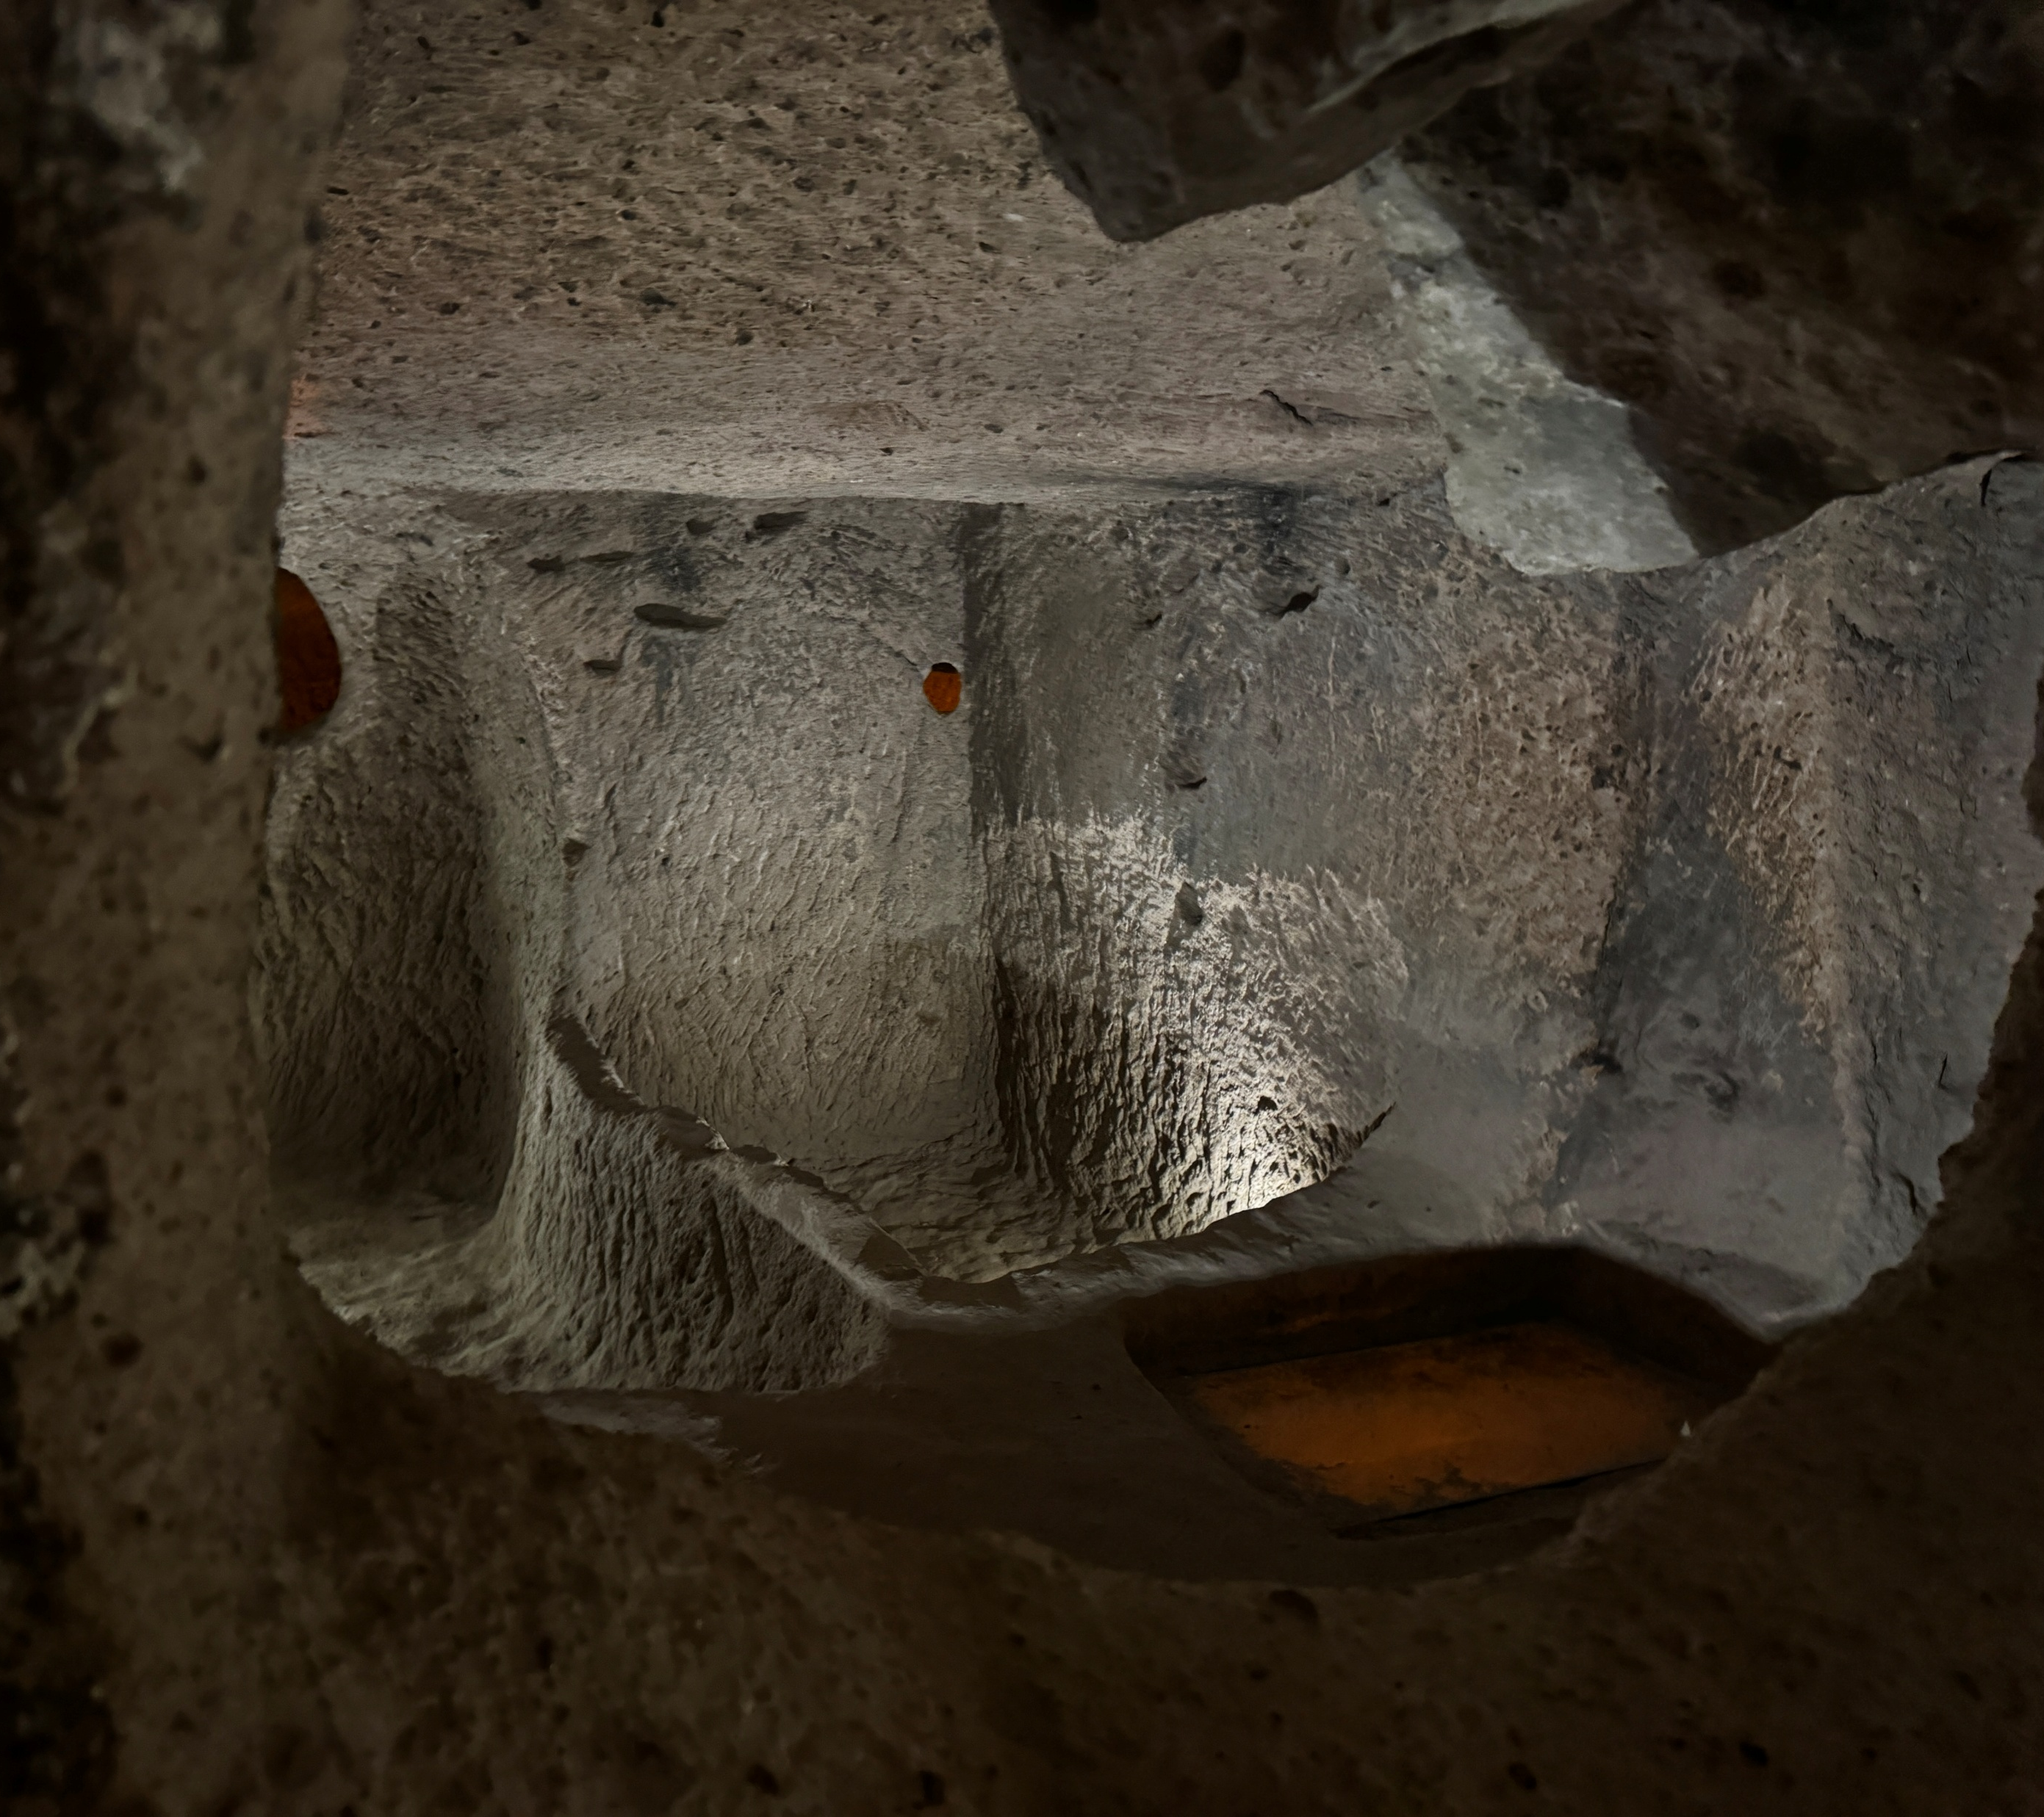
Thursday
We visited one of many underground cities in Cappadocia in Kamyakli then we visited ‚,Ihlara’’ sink hole

Slide 8
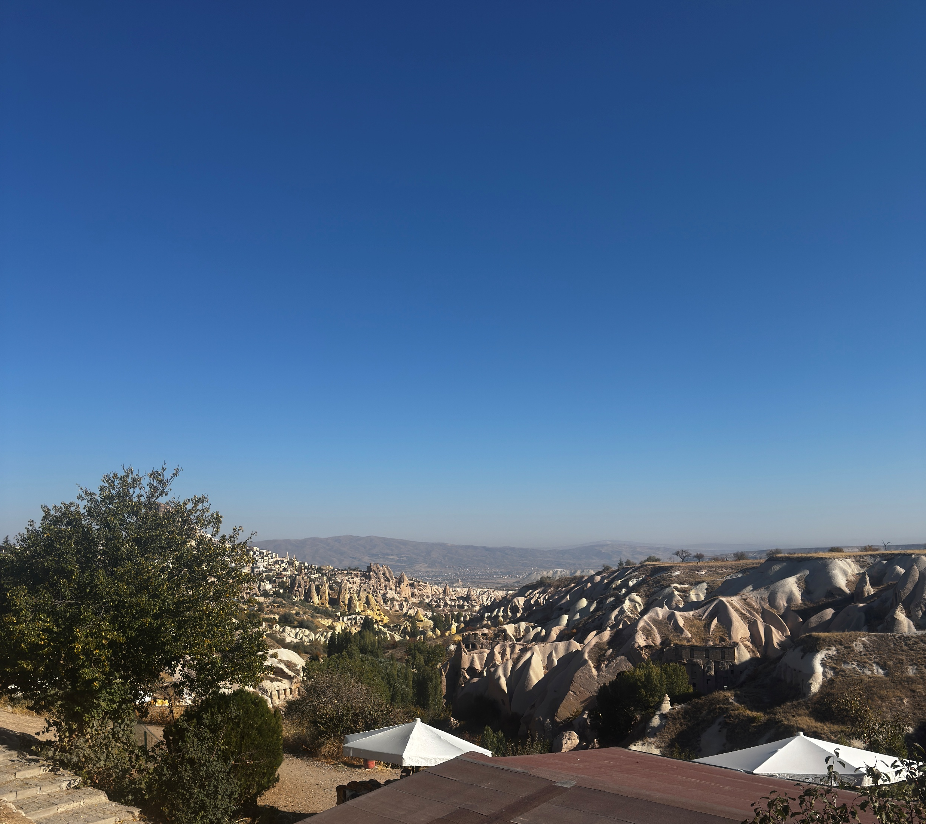
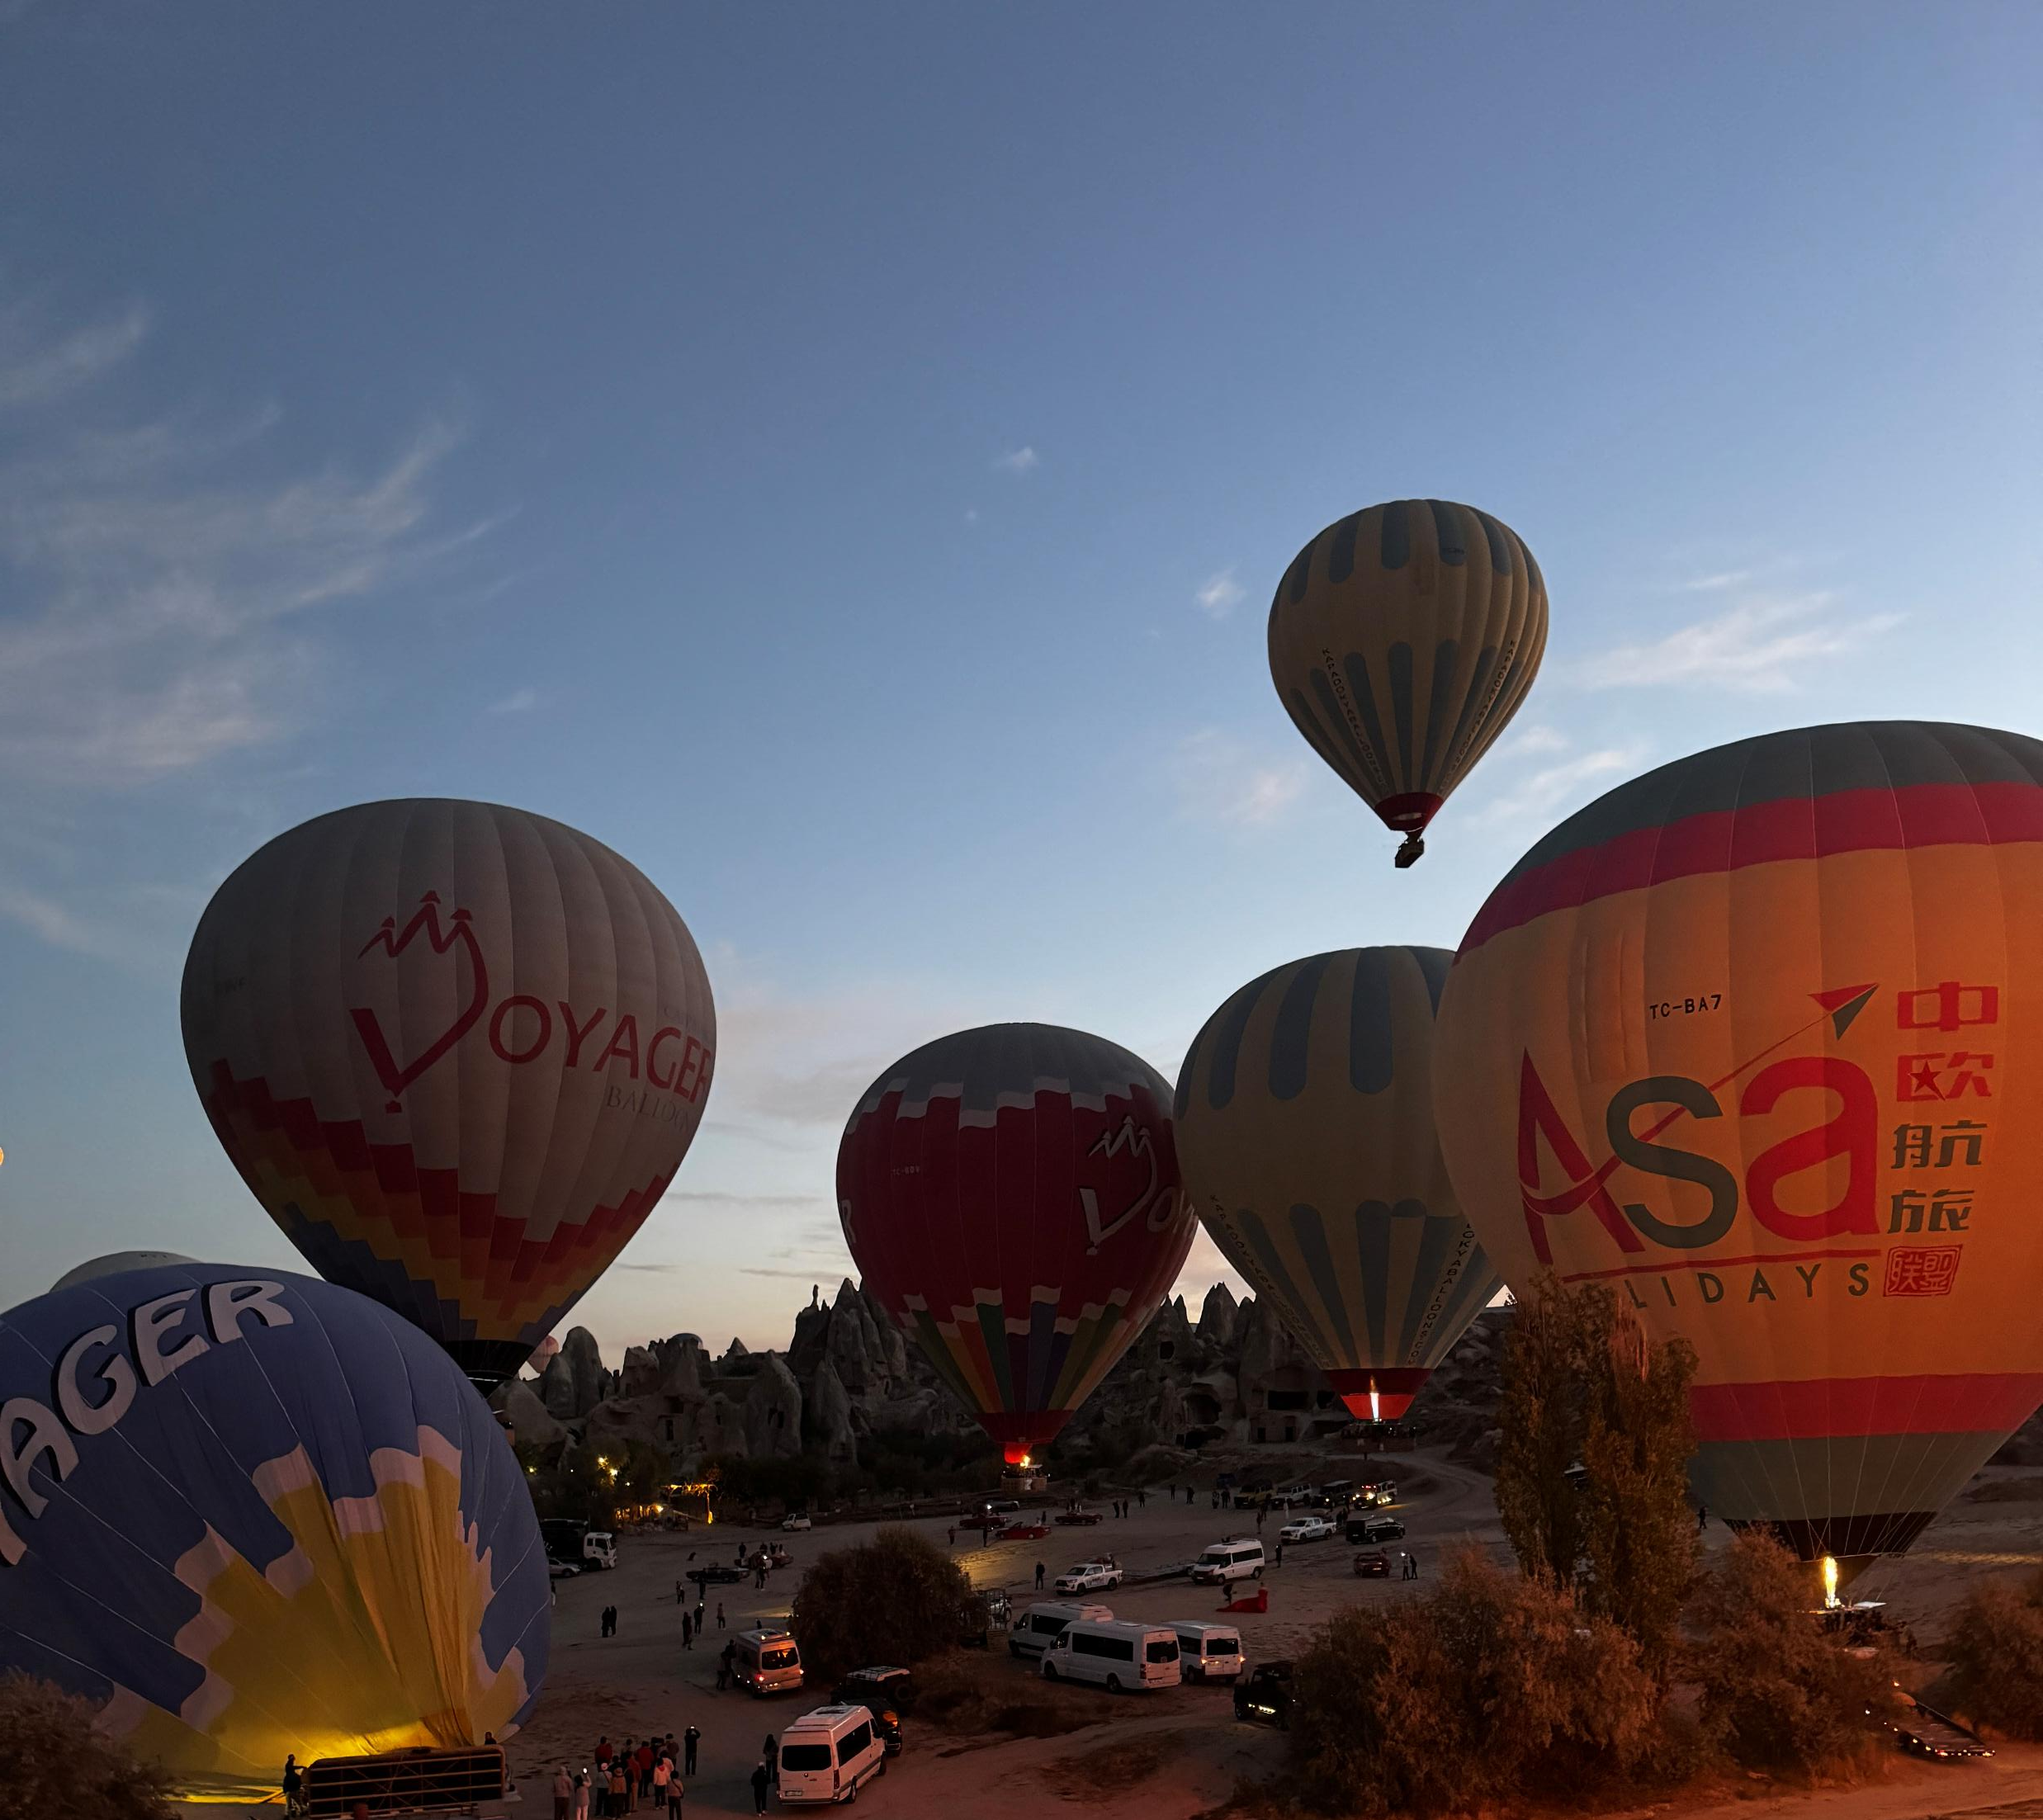
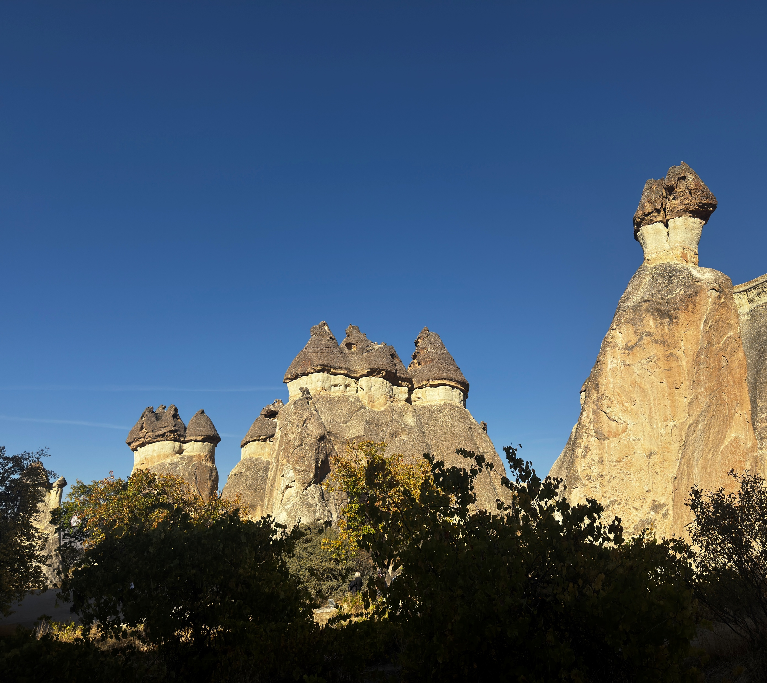
Friday
We were watching hot air baloons then we visited pigeon valley and visited Paşabağları Örenyeri museum

Slide 9
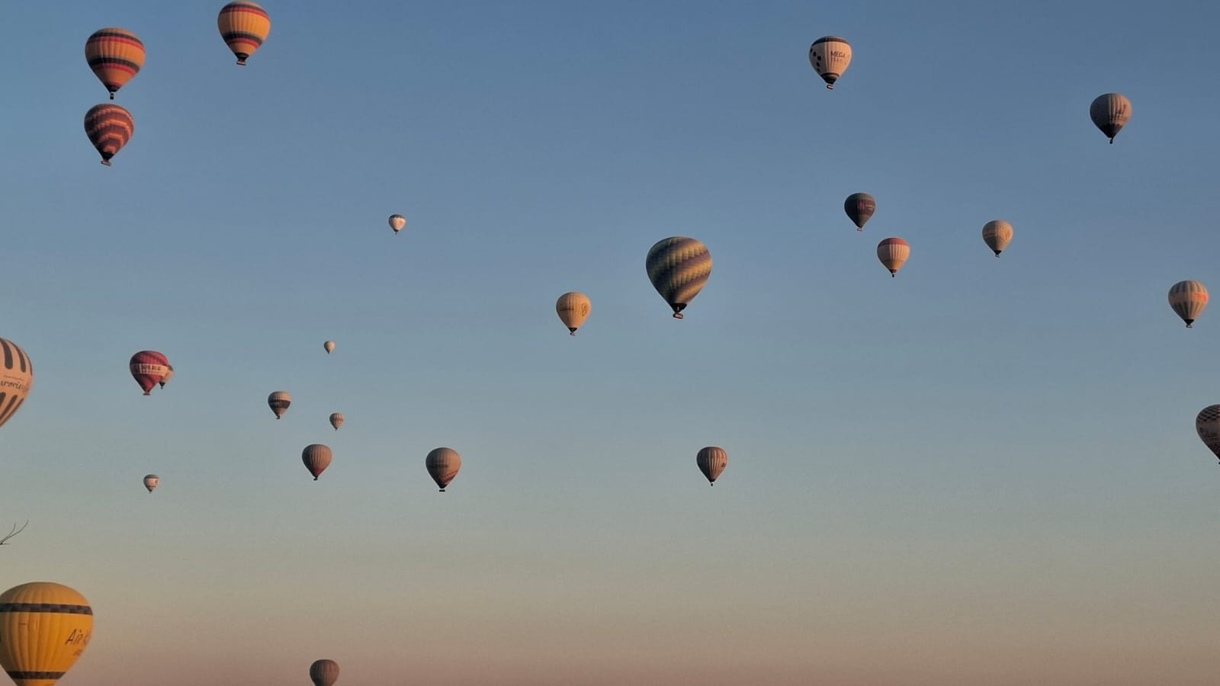
Favourite things
Juliana:hot air baloons
Stanisław:hot air baloons, turkish pizza
Marcin:hot air baloons

Slide 10
Authors
Juliana Śliwka
Stanisław Łabuda
Marcin Pyć

Slide 11
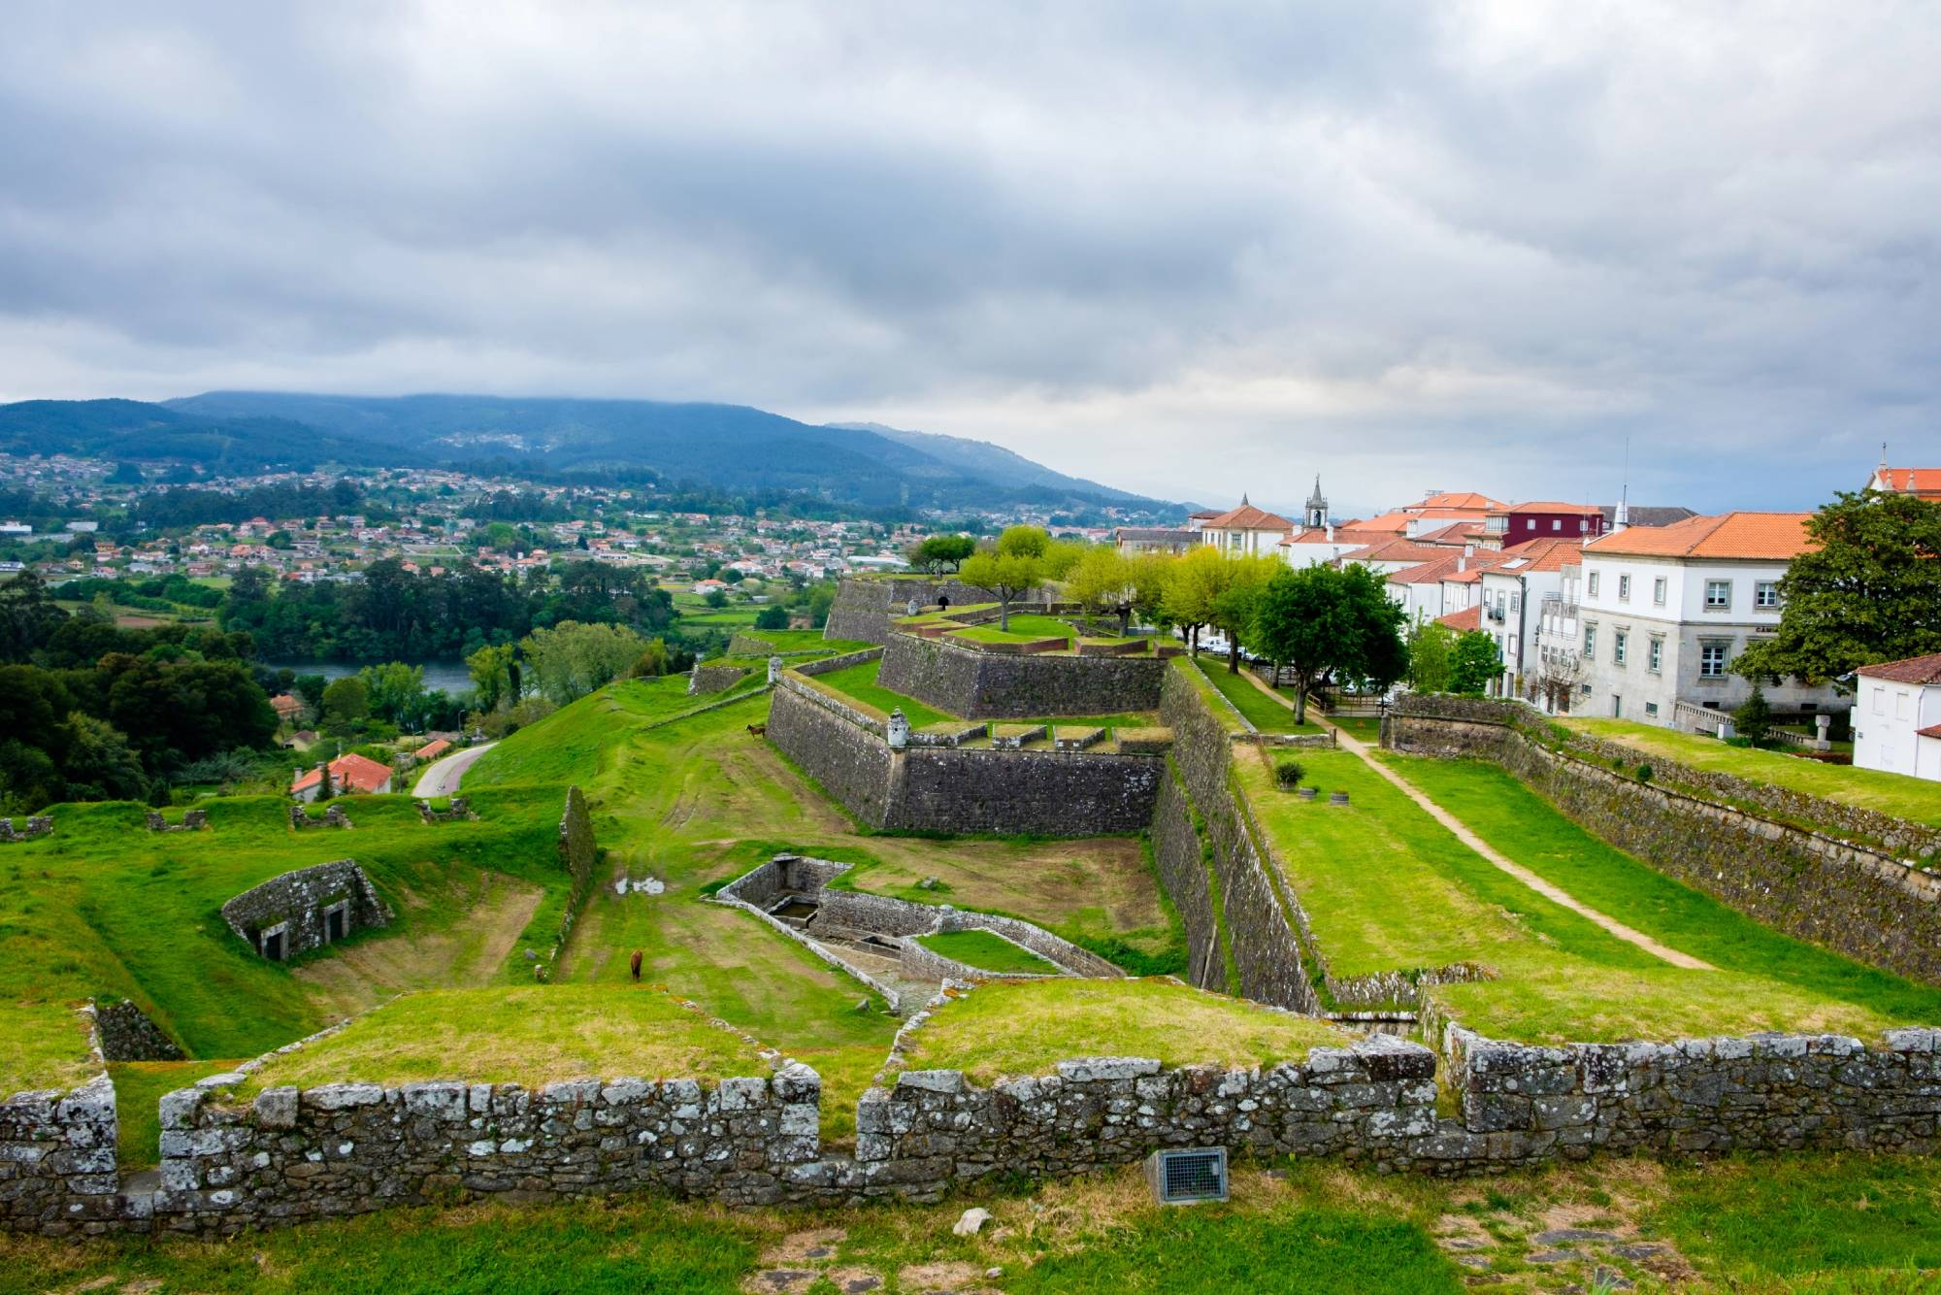
Portugal trip
15-21.03.2026

Slide 12

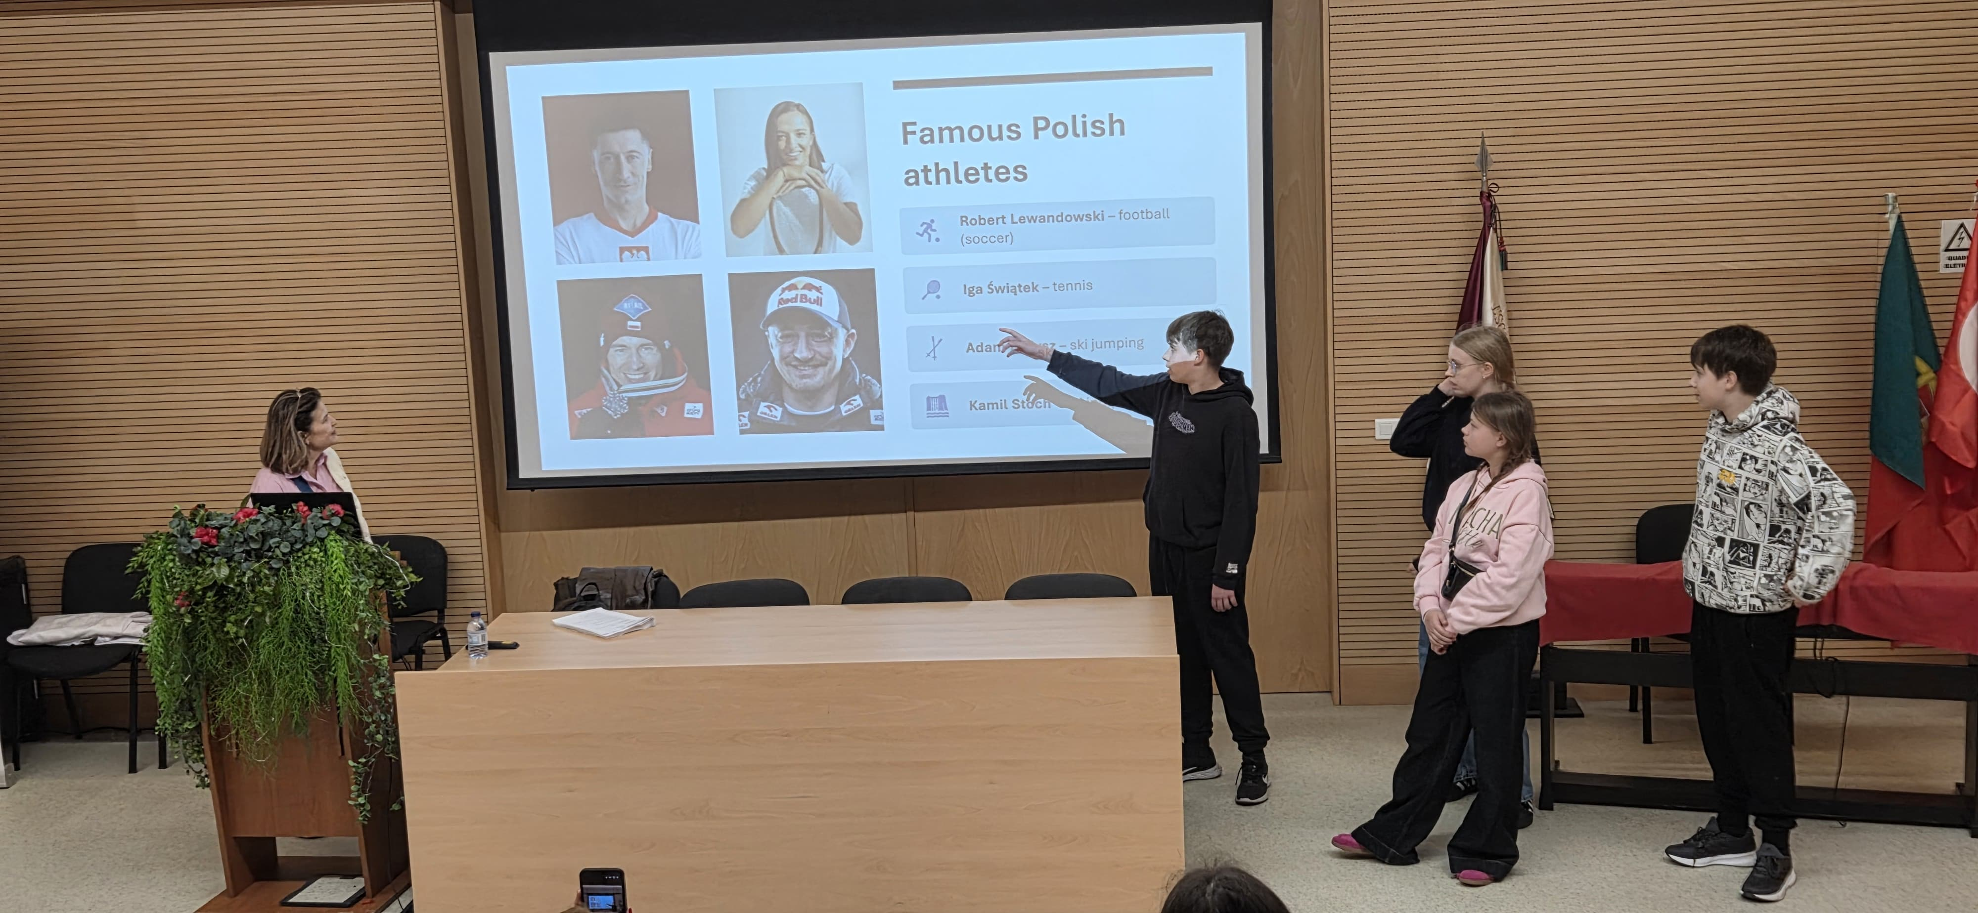
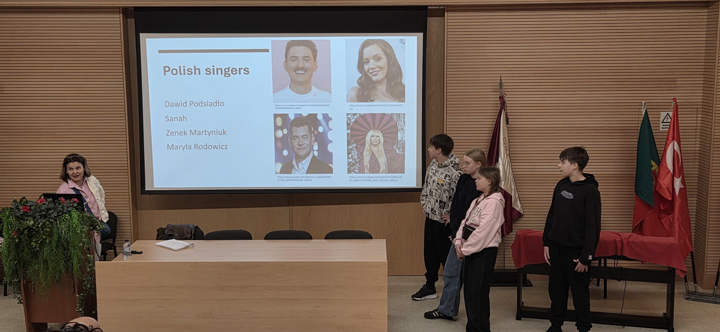
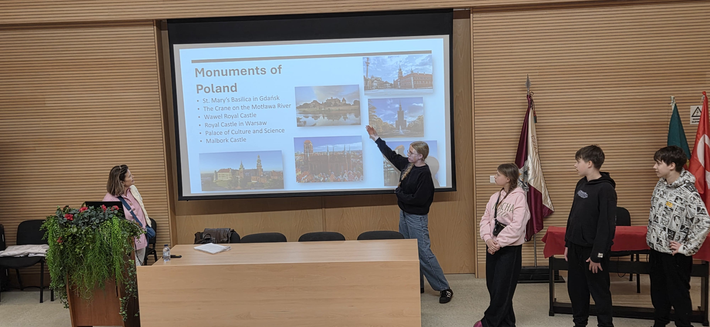
Sunday
On Sunday, we set off on our trip to Portugal

Slide 13
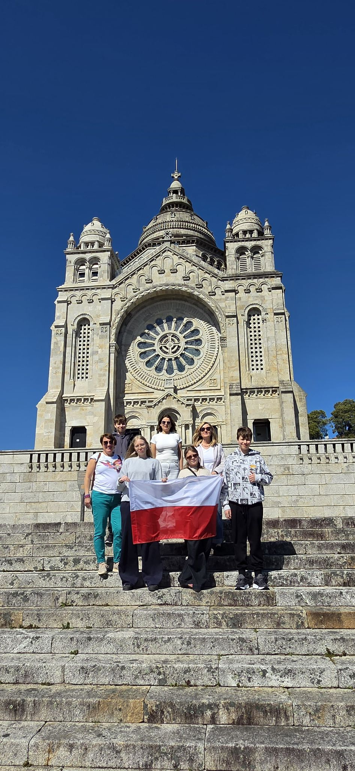
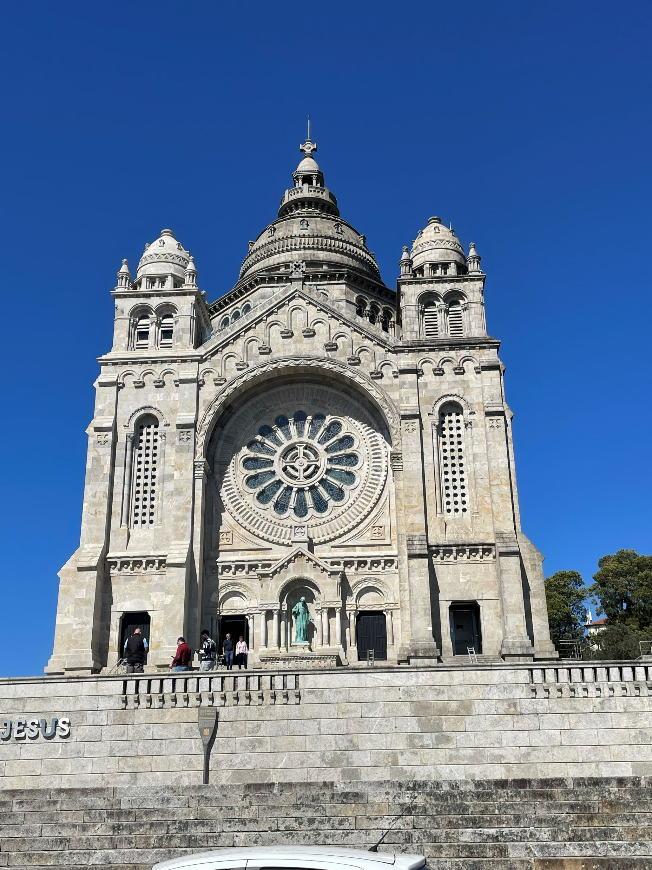
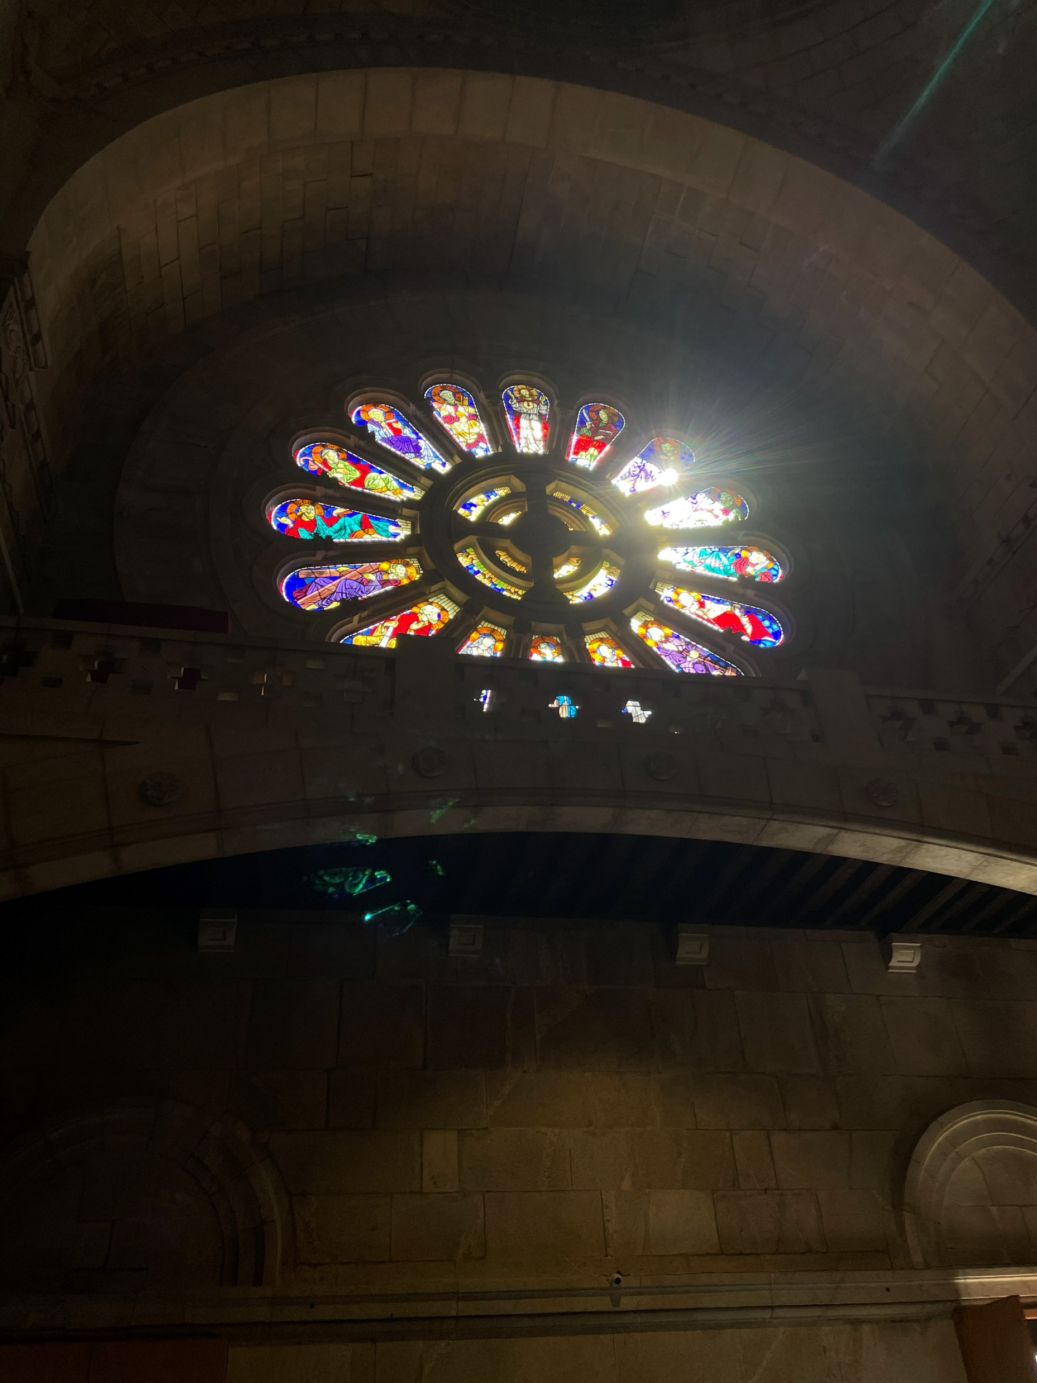
Monday
We were at school where we talked about our countries and we started to get to know each other.

Slide 14


Tuesday
We travelled to Viana do Castelo, where we saw sanctuary of the Sacred Heart of Jesus

Slide 15
Tuesday
We travelled to Viana do Castelo, where we saw sanctuary of the Sacred Heart of Jesus

Slide 16
Tuesday
We travelled to Viana do Castelo, where we saw sanctuary of the Sacred Heart of Jesus

Slide 17
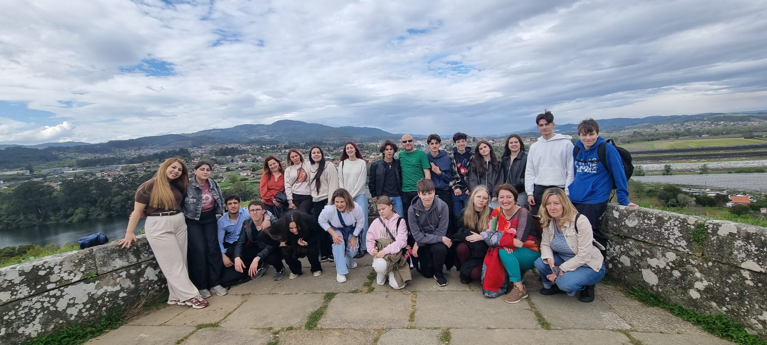
Tuesday
Wednesday we could see what the lessons look like. Then there was an integration game. At the end of the day we saw the Valença fortresses.
We travelled to Viana do Castelo, where we saw sanctuary of the Sacred Heart of Jesus

Slide 18
Wednesday
Wednesday we could see what the lessons look like. Then there was an integration game. At the end of the day we saw the Valença fortresses.

Slide 19
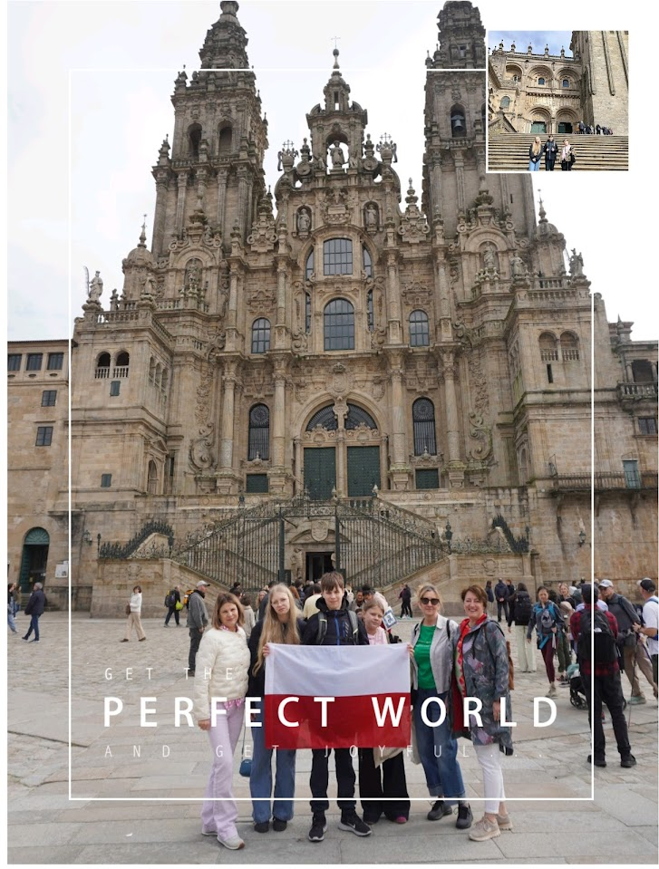
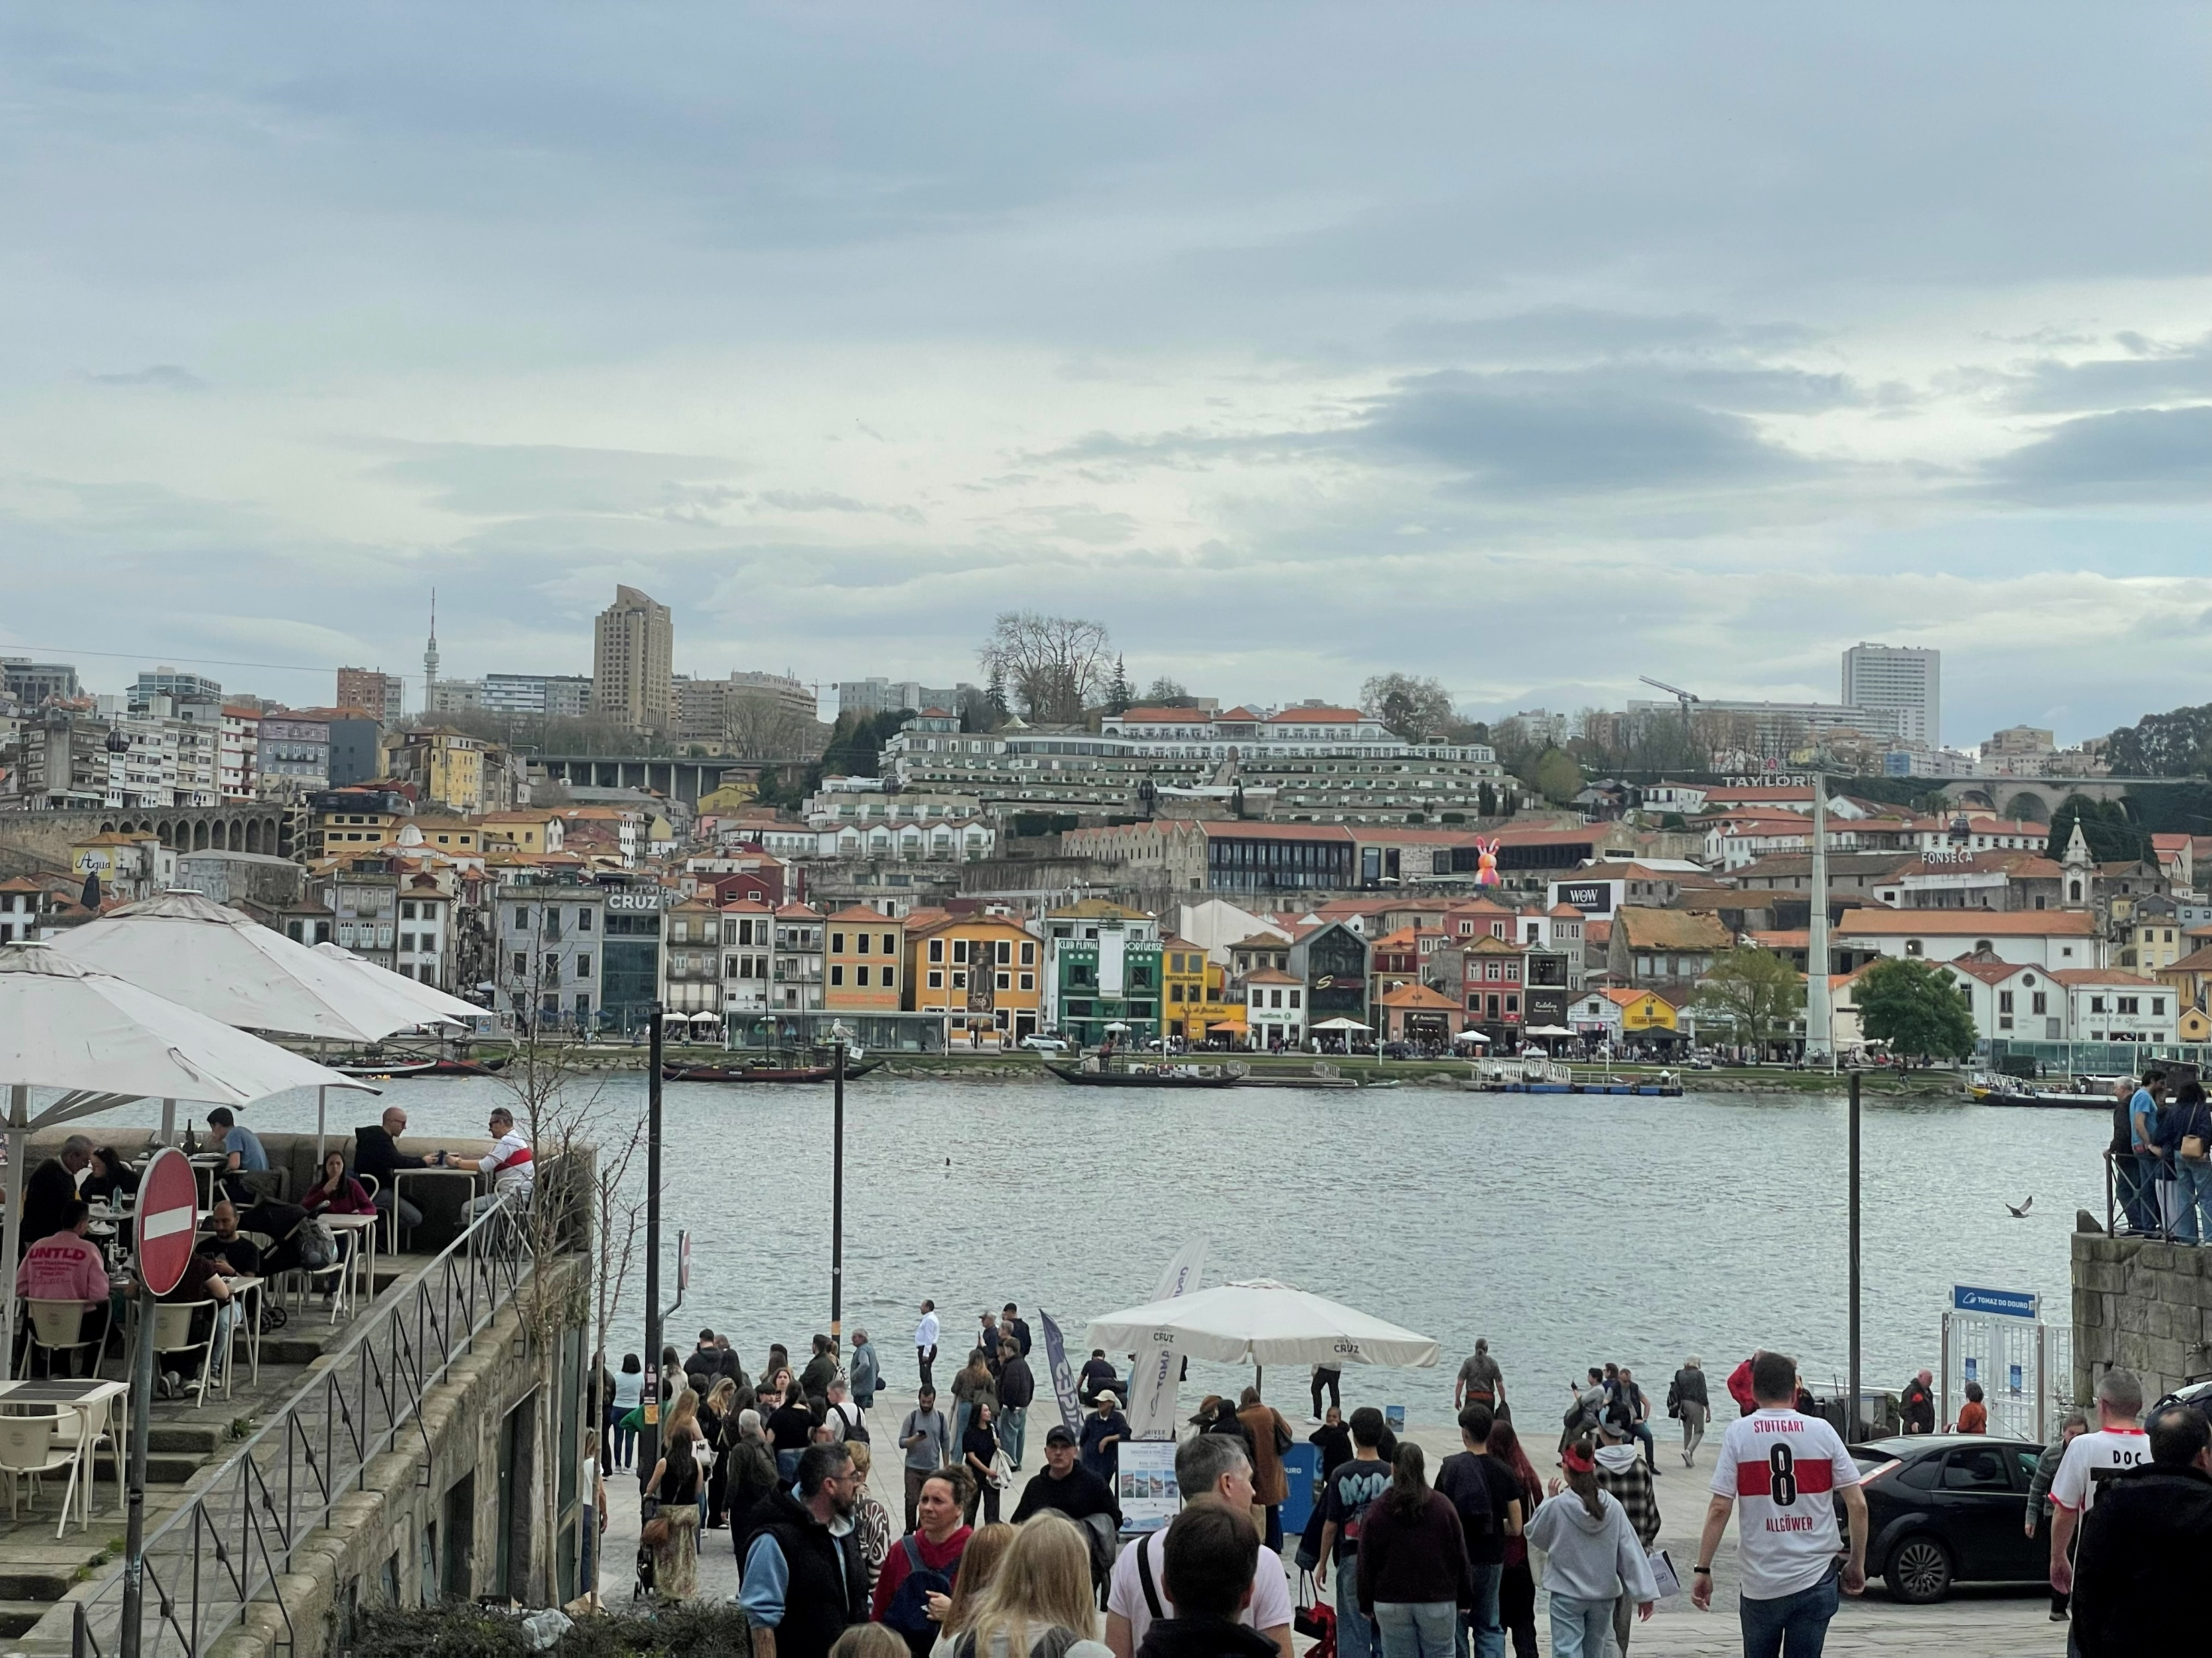
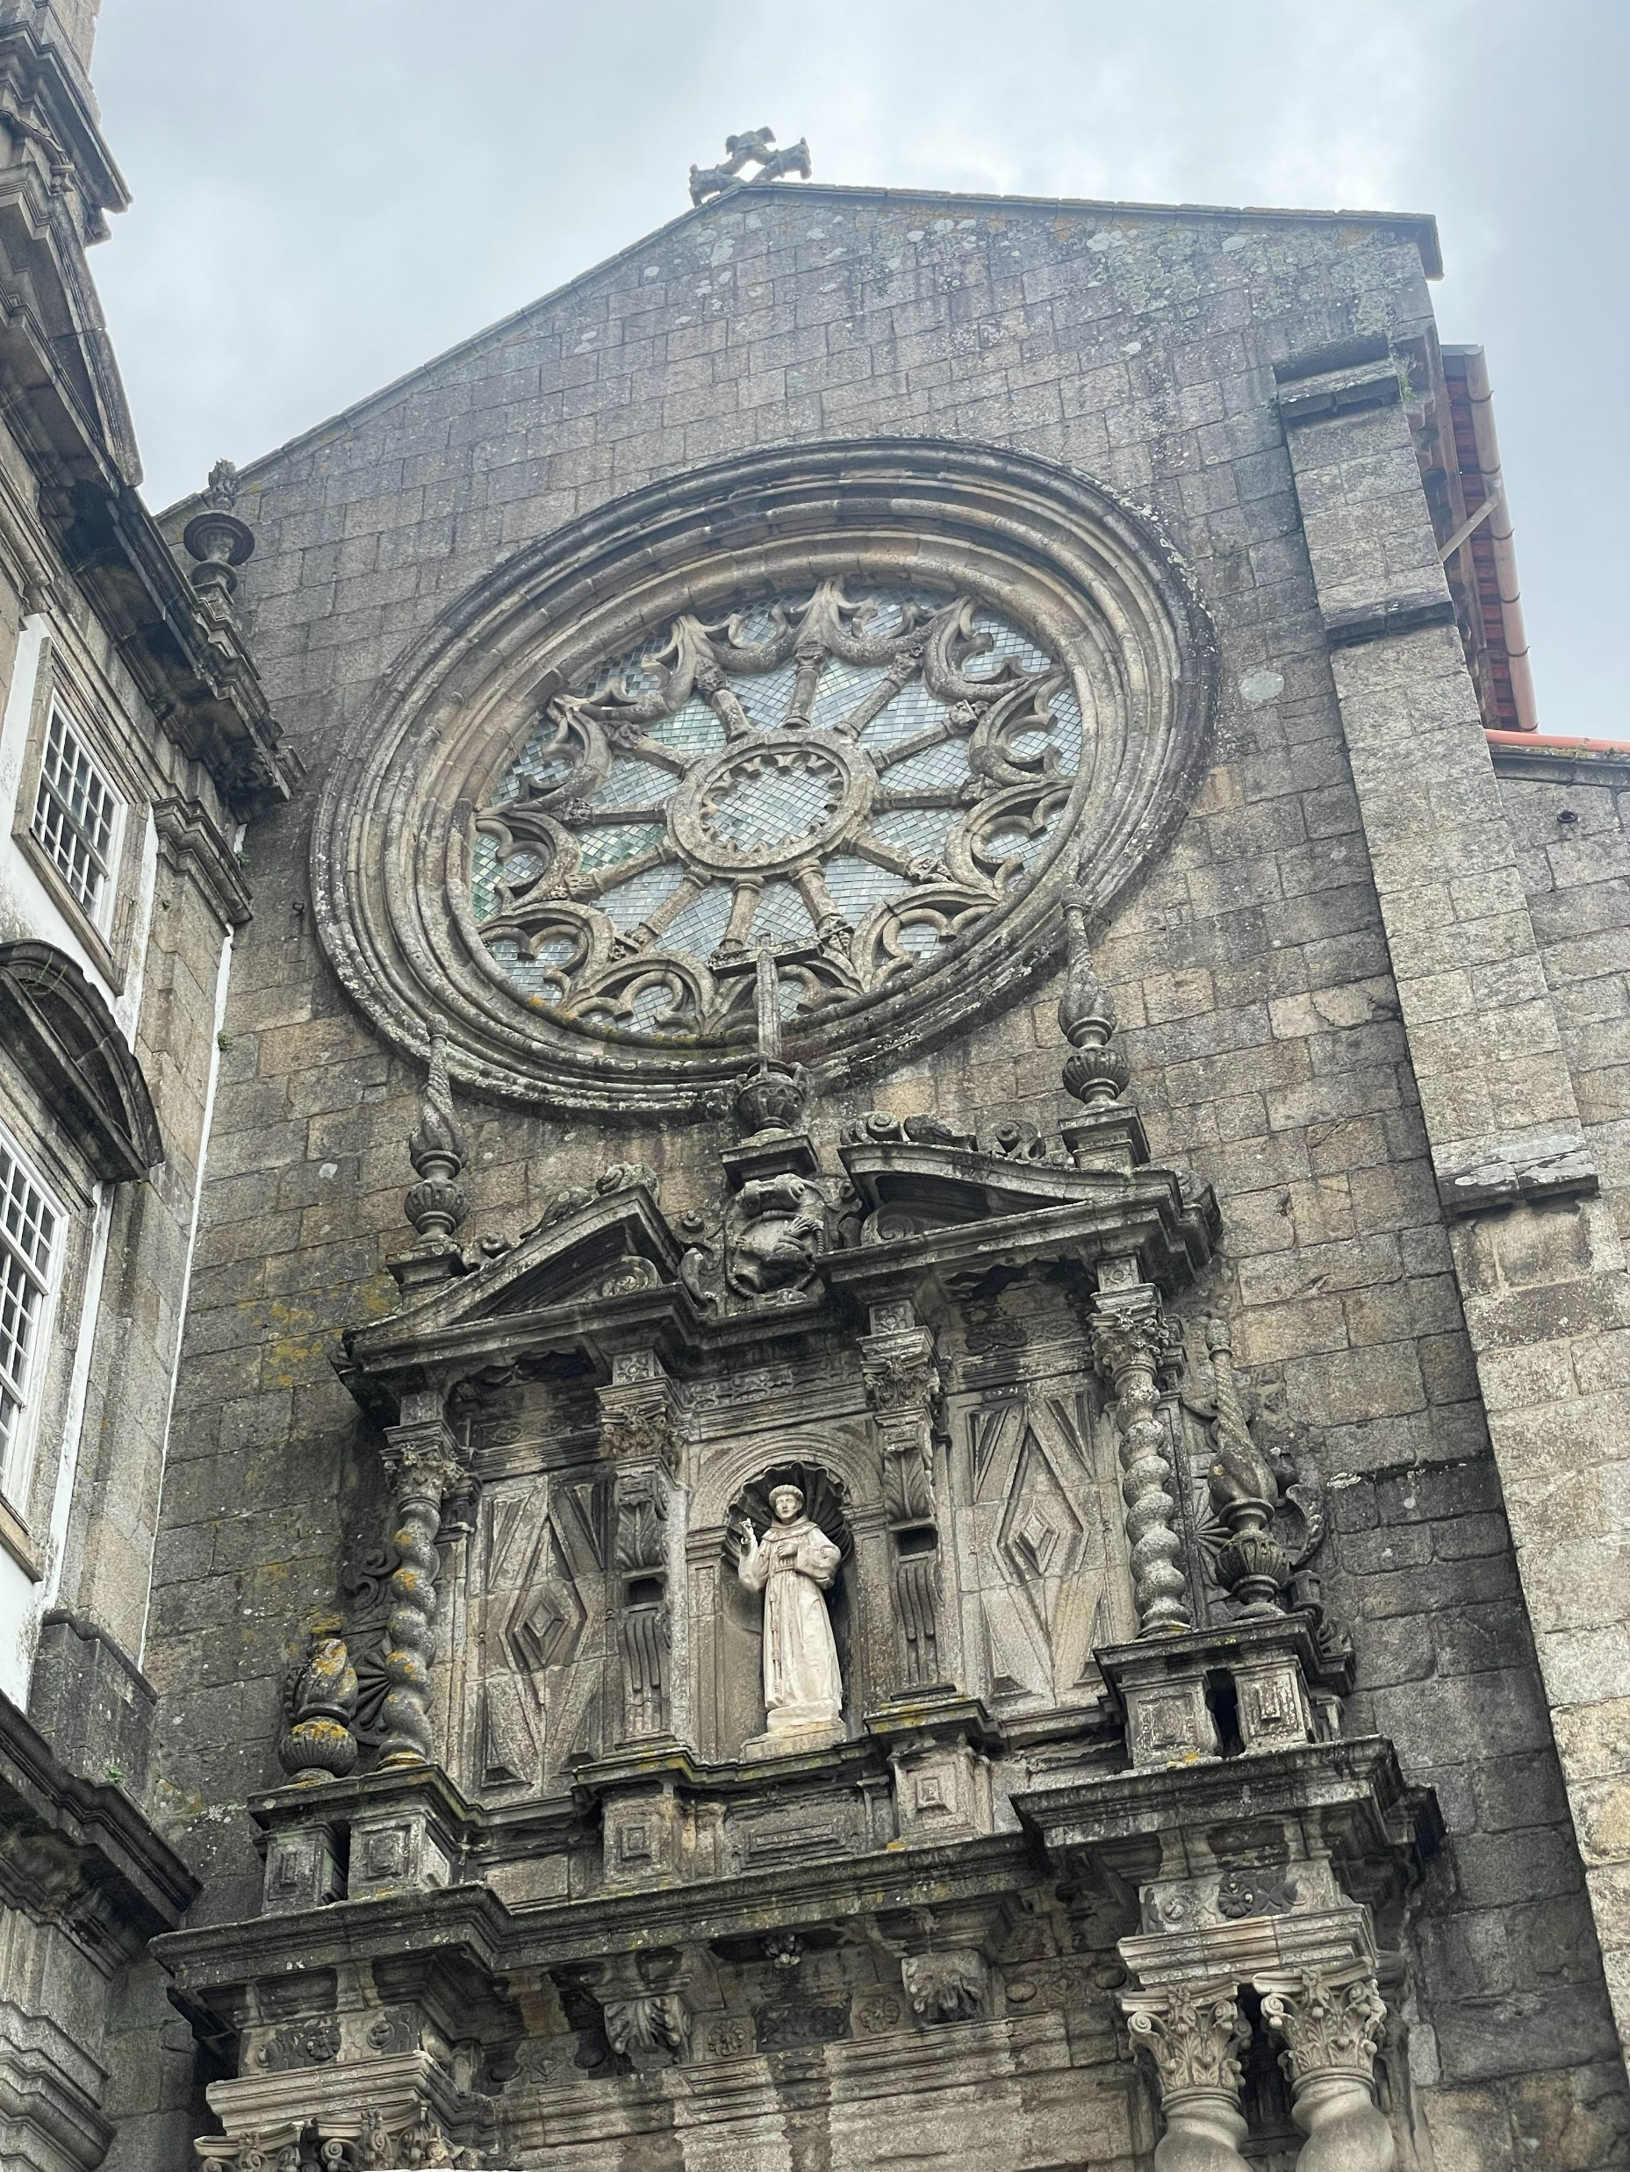
Thursday
We went to Porto where we saw the city and S. Francisco Church.
We visited the Cathedral of Santiago Compostela. At the end of the day, there was a dinner and a farewell party.

Slide 20
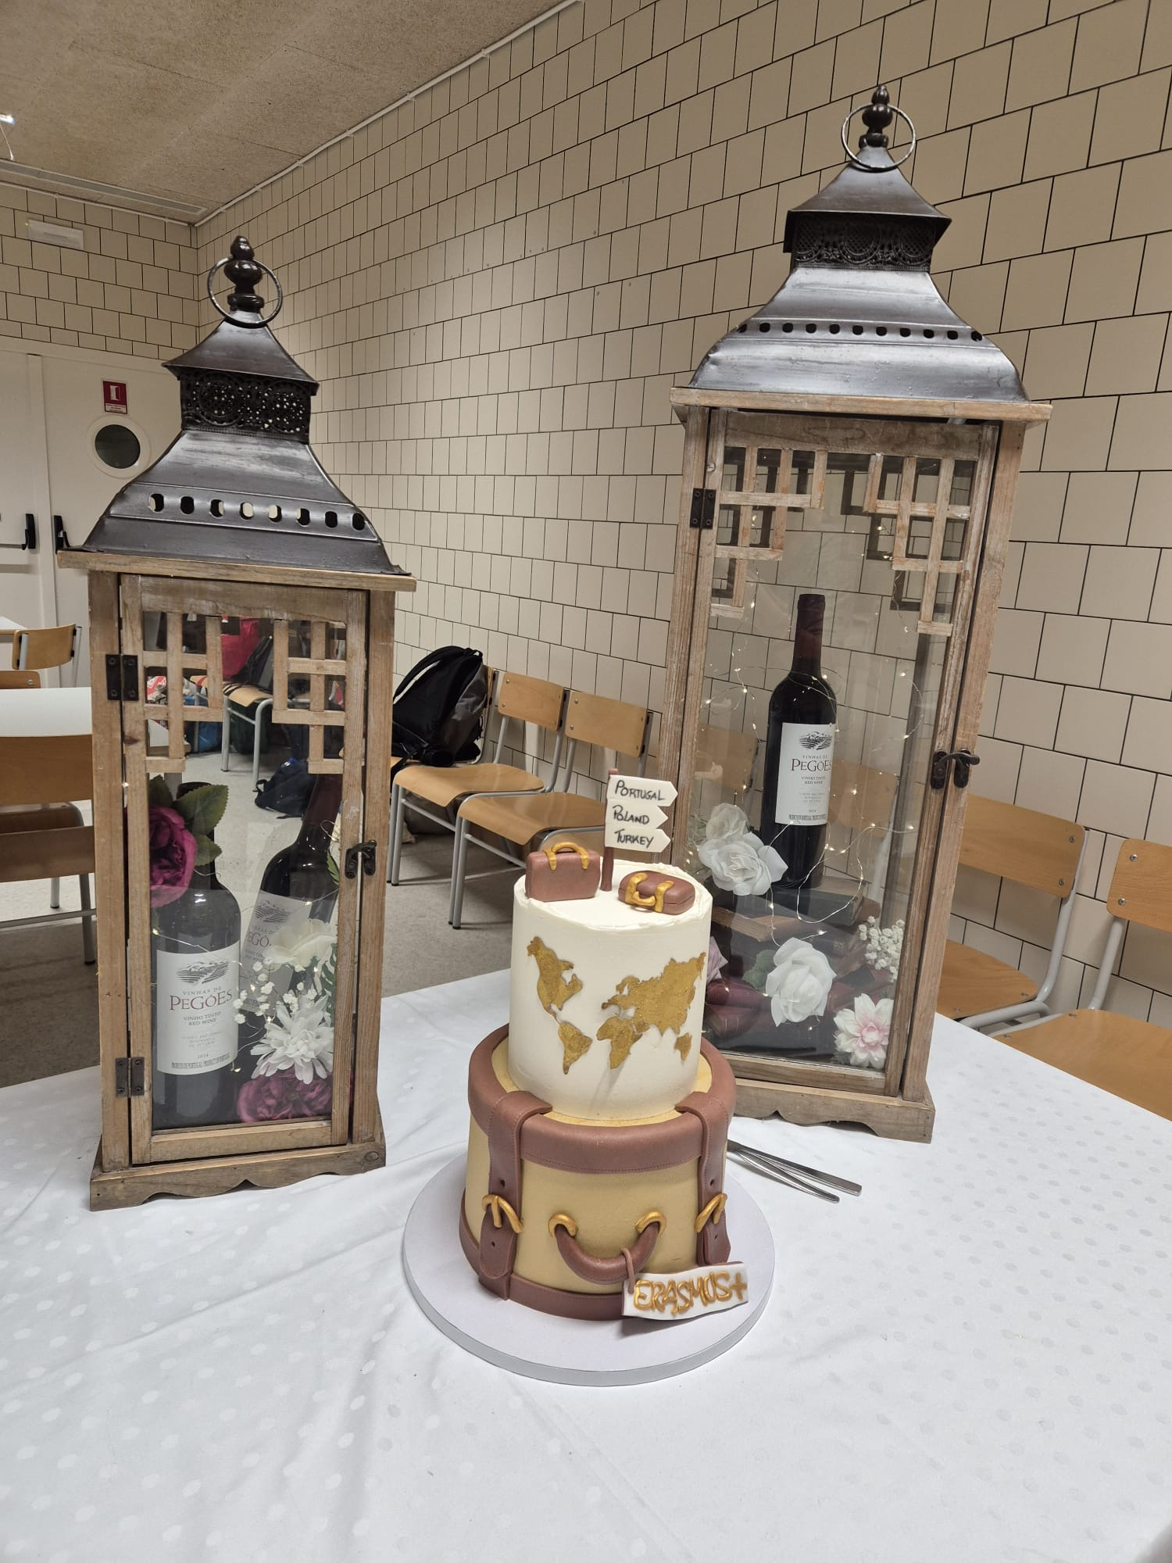
Friday
We visited the Cathedral of Santiago de Compostela. At the end of the day, there was a dinner and a farewell party.

Slide 21
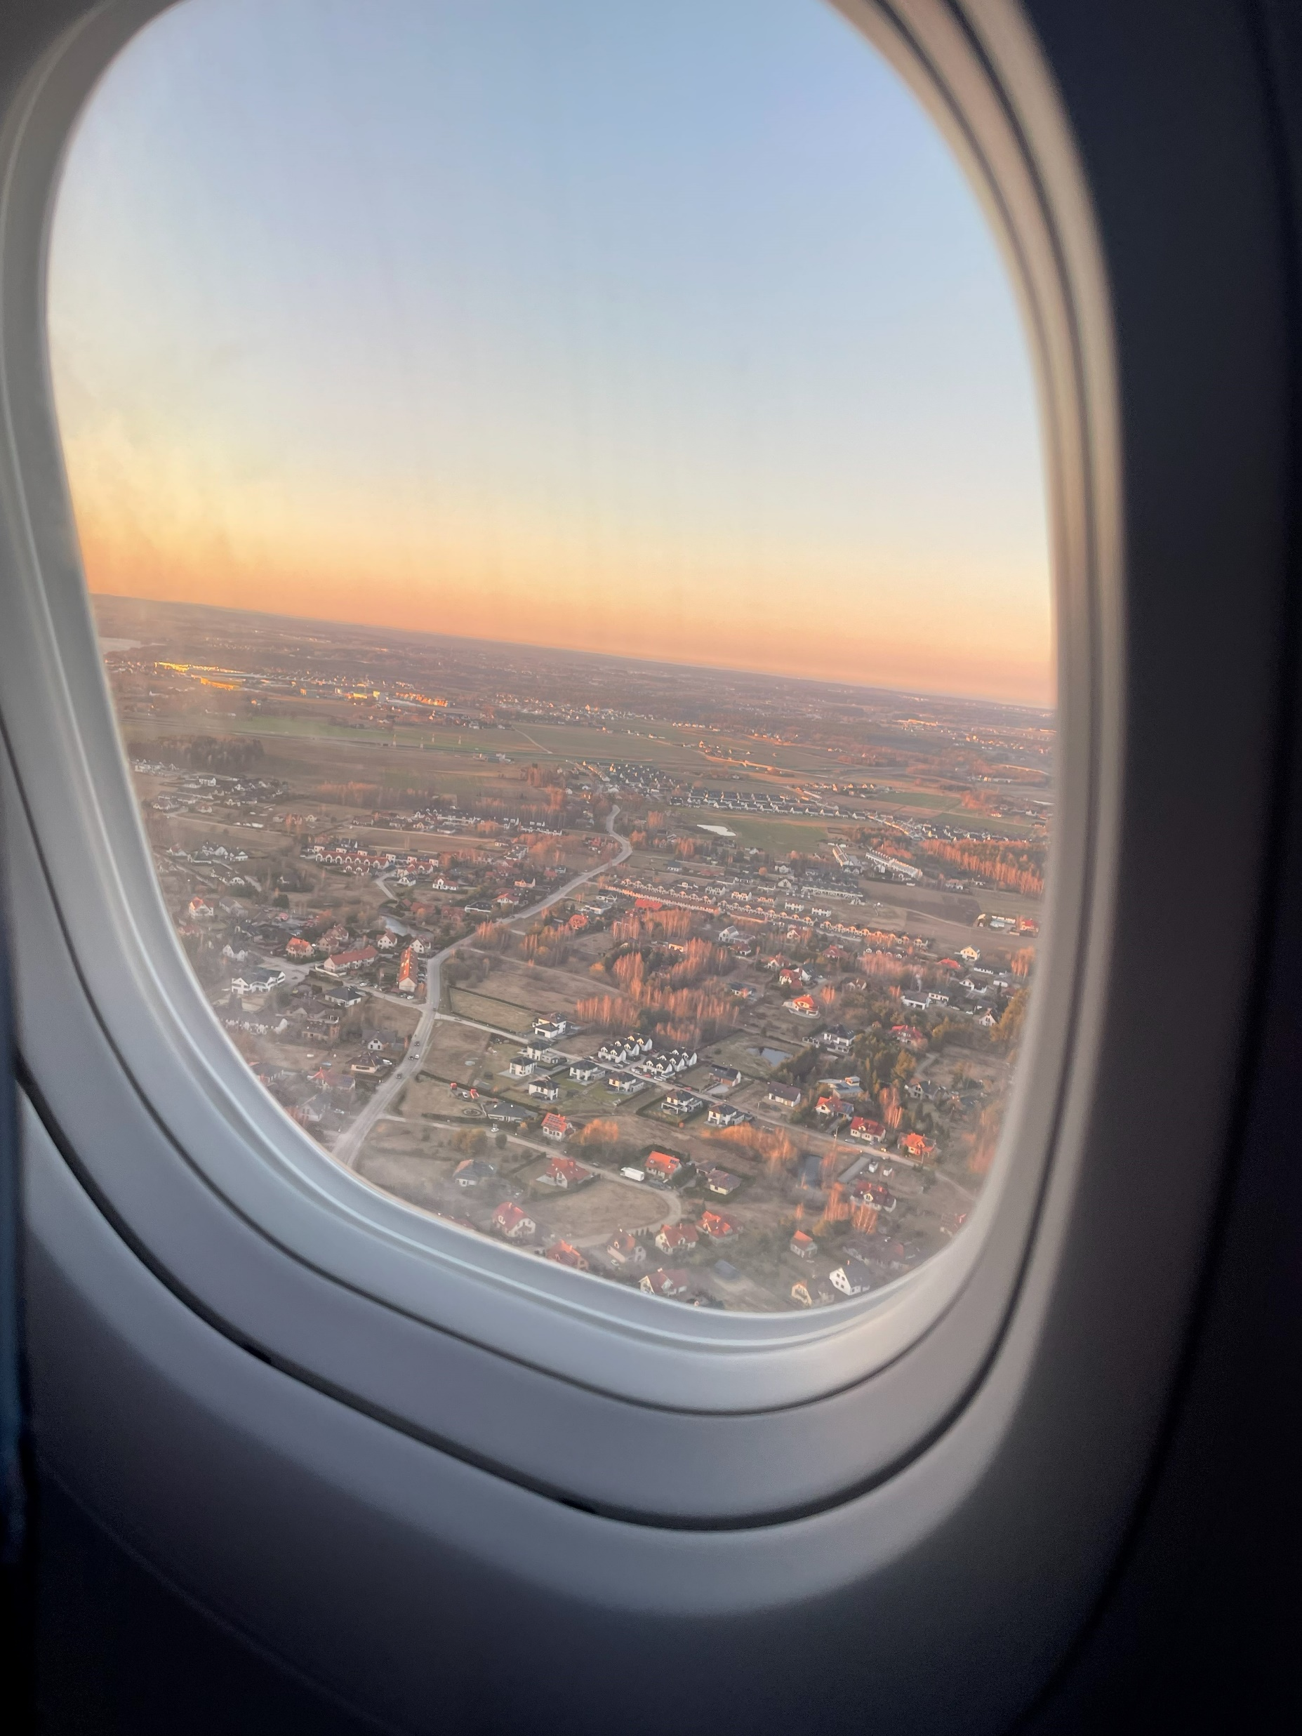
Saturday
On Saturday, we said goodbye to our hosts and returned to Poland

Slide 22
Our Favourite things
Ala
  - Porto
Julia
  - Spain and Porto
Jan
  - Pastéis de Nata and views
Bartek
  - views

Slide 23
Authors
Ala
Julia
Jan
Bartek

Slide 24
That's all – have a lovely stay in Poland

