Slide 1
Ozone holes
Perfomed by Bohdanova Tetiana

Slide 2
what is the ozone hole?
An ozone hole is an accidental drop in ozone in the Earth's breath.
According to the theory generally accepted in the scientific community and WMO, in the second half of the 20th century, the increasing manifestation of anthropogenic pollution in the form of emissions of CFCs containing chlorine and fluorine reaches a significant degree of thinning of the layer

Slide 3
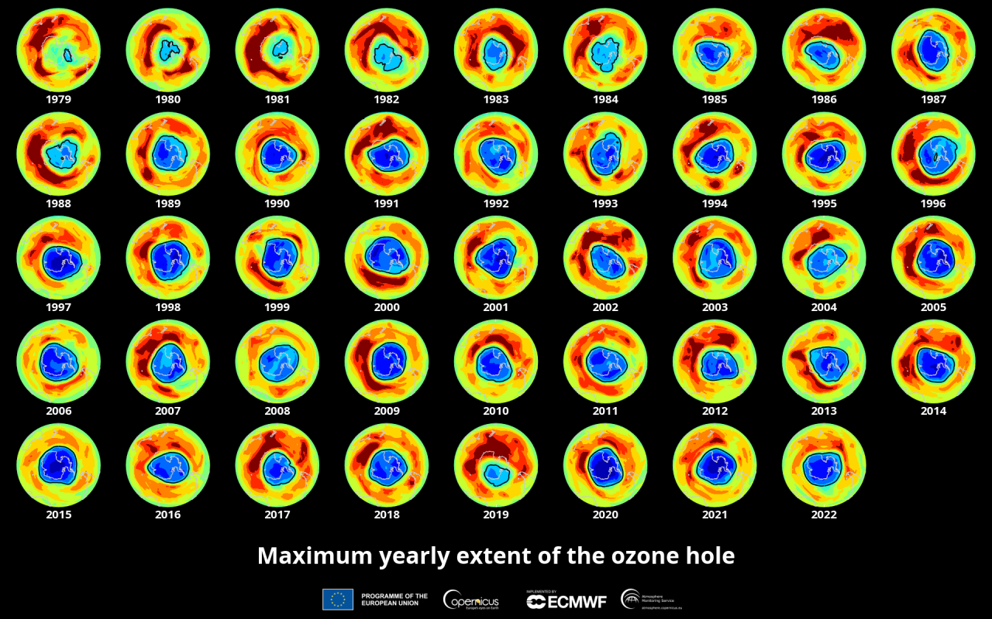
surface of the ozone hole
In 2018, the area of ​​the ozone hole over Antarctica was about 22.8 million k$m^{2}$.
In 2018, the area of ​​the ozone hole over Antarctica was about 22.8 million km^2.
In the years 2000-2017, the average annual values ​​ranged from 17.4 to 25.6 million k$m^{2}$.
In the years 2000-2017, the average annual values ​​ranged from 17.4 to 25.6 million km^2.

Slide 4
causes and mechanisms
During polar nights, ozone is not formed because ultraviolet radiation does not affect oxygen molecules
Ozone molecules of high mass descend to the surface of the Earth and are destroyed, because they are unstable at normal pressure
Chlorine atoms can destroy large amounts of ozone in the stratosphere
Nitric oxide (II)(NO) can accelerate the destruction of the ozone layer

Slide 5
implications
The weakening of the ozone layer increases the flow of ultraviolet solar radiation
Then radiation penetrates the ocean waters
And leads to an increase in mortality among marine animals and plants.

Slide 6
Ways of prevention
Improving cleaning structures on flue gas ducts
Complete transition to the use of organic fertilizers
Manufacturing and using environmentally-safe vehicles
According to scientists' forecasts, the problem may be solved by 2070

Slide 7
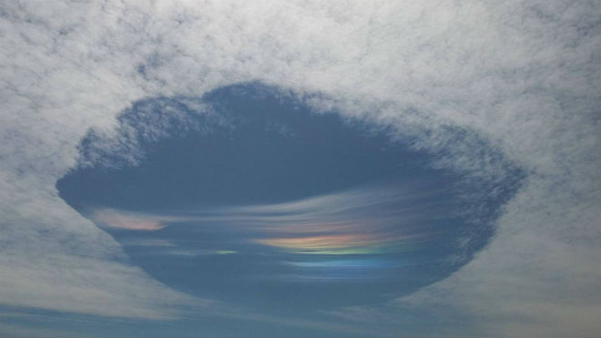
The theory
Recent studies have shown that the map of ozone holes completely repeats the map of mathene deposits. On this basis, a new theory appeared - there were always holes

Slide 8
Thank You for attention!
sources: https://karbon-cns.com.ua/
https://ozonewatch.gsfc.nasa.gov/
https://www.bbc.com/future/article/20220321-what-happened-to-the-worlds-ozone-hole

