Slide 1

The air and its components
Julia Gudojć

Slide 2

What is the air?
Air is a homogeneous mixture of various substances, mainly gases. It is colorless, odorless, tasteless and poorly soluble in water. Air is essential for the life of man and other organisms on Earth. In industry, it is used in combustion processes and as a raw material for the production of nitrogen, oxygen, argon and noble gases. It is the earth's atmosphere.

Slide 3
Interesting facts about air
The countries with the cleanest air are New Zealand, Brunei and Sweden, while the most polluted are Saudi Arabia, Qatar and Egypt.
A person at rest uses about 5-7 liters of air per minute, while a person who runs needs about 50 liters.
In Poland, one of the taxes is levied on air. It is a tourist tax that is collected from tourists in environmentally attractive towns or in health resorts.

Slide 4
The air components
the air components
of constant content
of variable content
nitrogen 78%
oxygen 21%
noble gases 1%
ozone
hydrogen
nitrogen oxides
carbon monoxide (IV)
ammonia
water vapor
lattice compounds

Slide 5
Nitrogen
Nitrogen is the basic component of air, it occupies about 78% of its entire surface. Together with oxygen, it is a "breathing mixture". It occurs in many chemical compounds present in living organisms (proteins). It is non-toxic to living organisms.
properties of nitrogen
physical
chemical
gaz
colorless
slightly soluble in water
boiling point -196°C
melting point -209°C
odorless
non-metallic
does not burn
does not sustain combustion

Slide 6
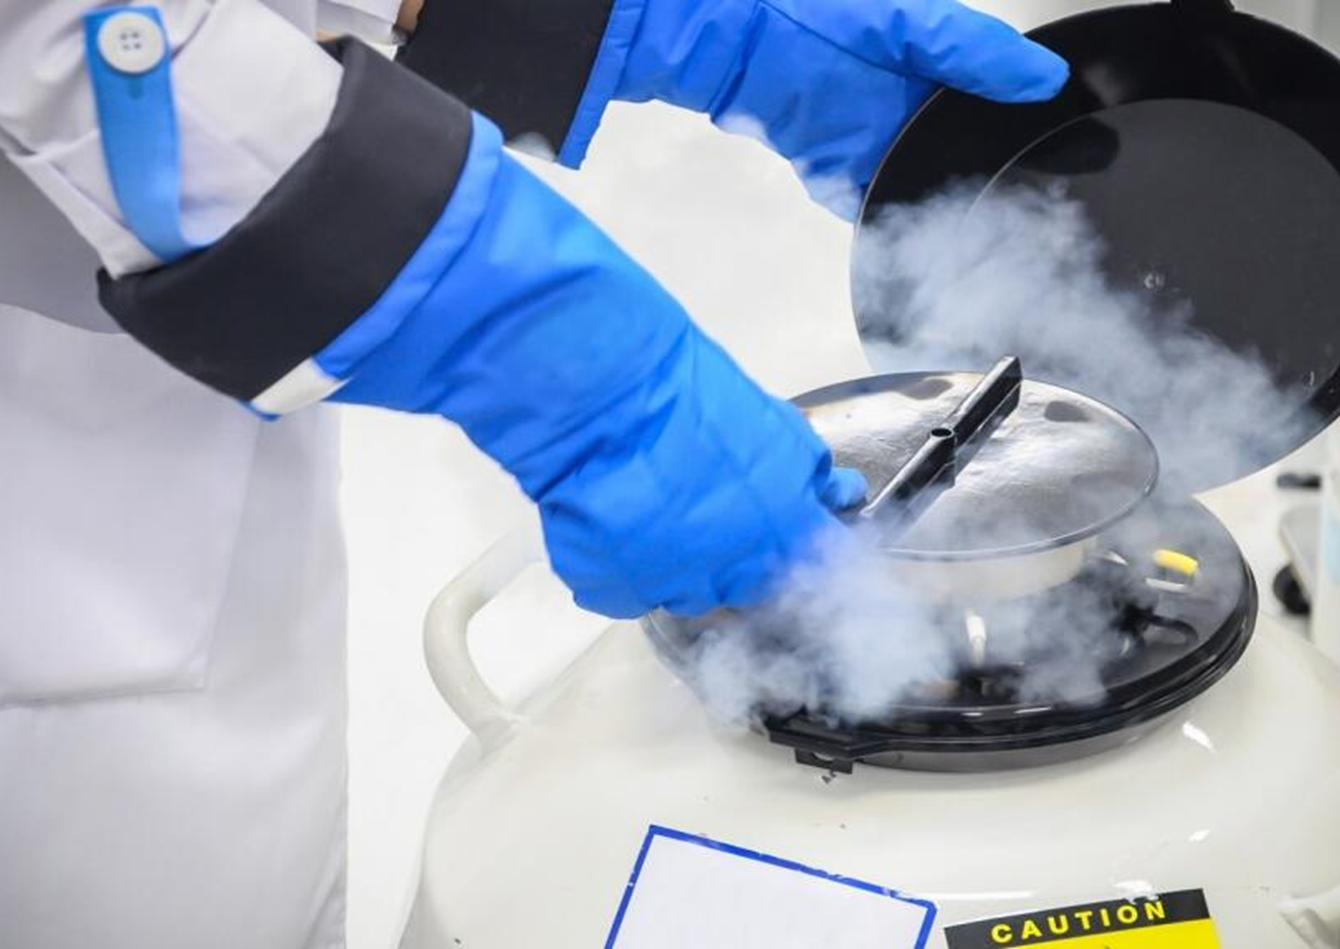
Nitrogen applications:
in the mining industry
in the food industry
in the oil and gas extraction industry
in the pharmaceutical industry
in the metal industry
in electronics
in fire prevention

Slide 7
Oxygen
Oxygen is the most important component of air, with a constant content, it occupies about 21%. It is essential for the life of most organisms.
properties of oxygen
physical
chemical
gas
colorless
slightly soluble in water
has a density greater than that of air
odorless
combines with non-metals and metals to from oxides
it sustains combustion, it does not burn itself

Slide 8
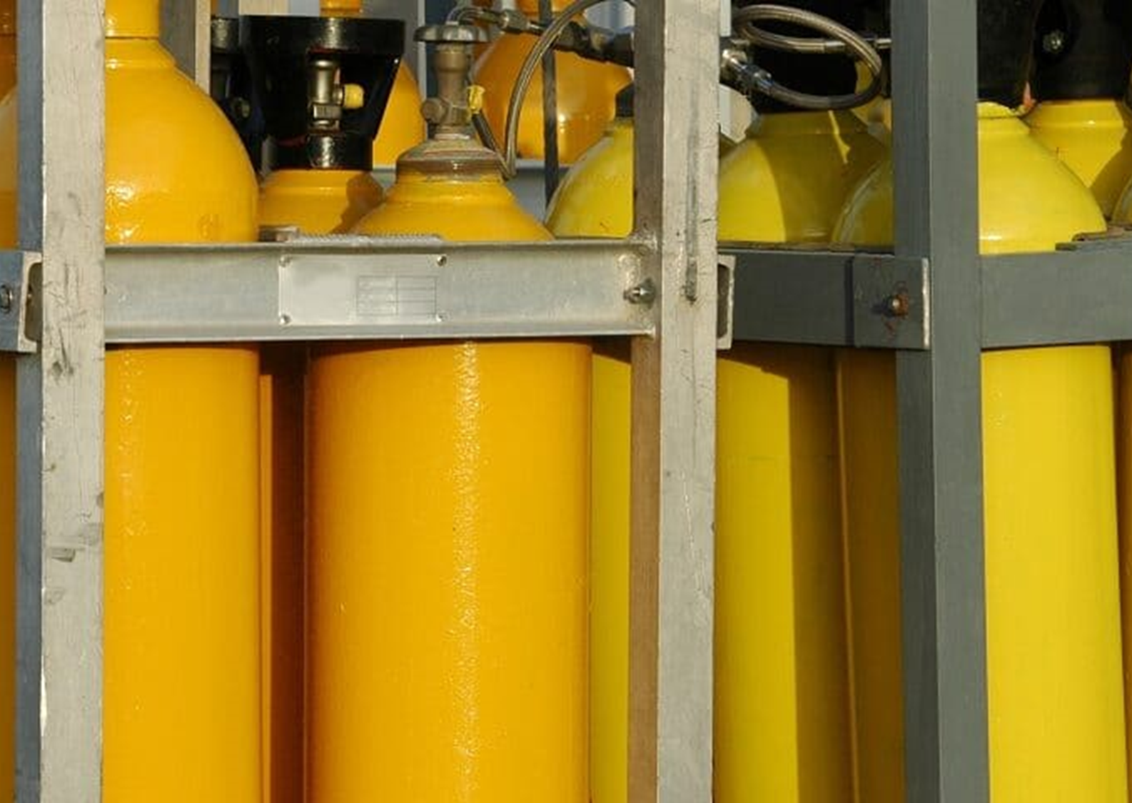
Oxygen applications:
as fuel in rockets and shuttles
in the generation of high temperatures in torches for welding and cutting metals
in hyperbaric chambers, for the treatment of dangerous skin damage
as a component of a mixture in cylinders for divers, astronauts and mountaineers
in oxygen therapies

Slide 9
Noble gases
Noble gases (or heliums) are components of air with a constant content, they occupy only 1% of it. The helium elements found in the air are helium, neon, argon, and krypton.

Slide 10
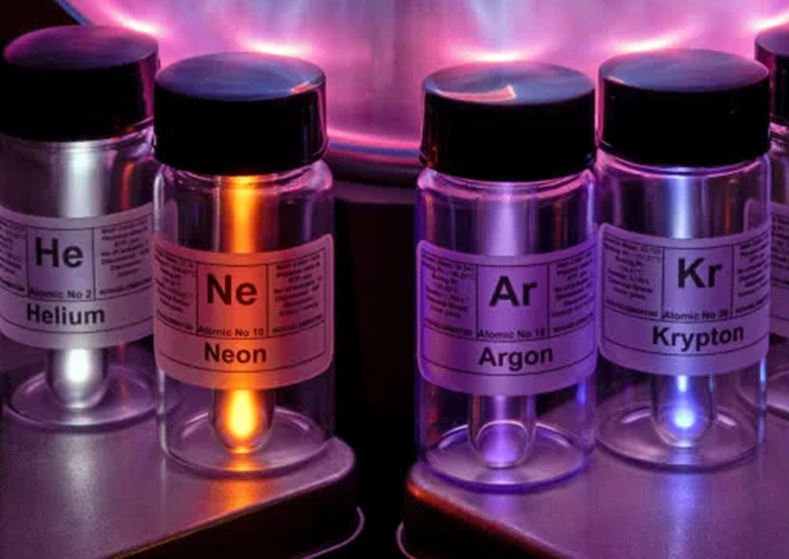
Noble gas applications:
cooling superconductors - helium
aerostat filler (balloons, airships) - helium
filler in colorful neon advertisements - neon
use in incandescent lamps - neon

Slide 11
Noble gas applications:
in electronics - argon
in lighting technology - argon
in the production of filament bulbs, fluorescent lamps, lasers and windows with high thermal efficiency - krypton

Slide 12

Thank you for your attention!
zpe.gov.pl
pl.wikipedia.org
platasa.com
siad.com
imtechgaz.pl
fajnepodroze.pl

